Slide 1

Secure
Infrastructure
From FourNet

Slide 2


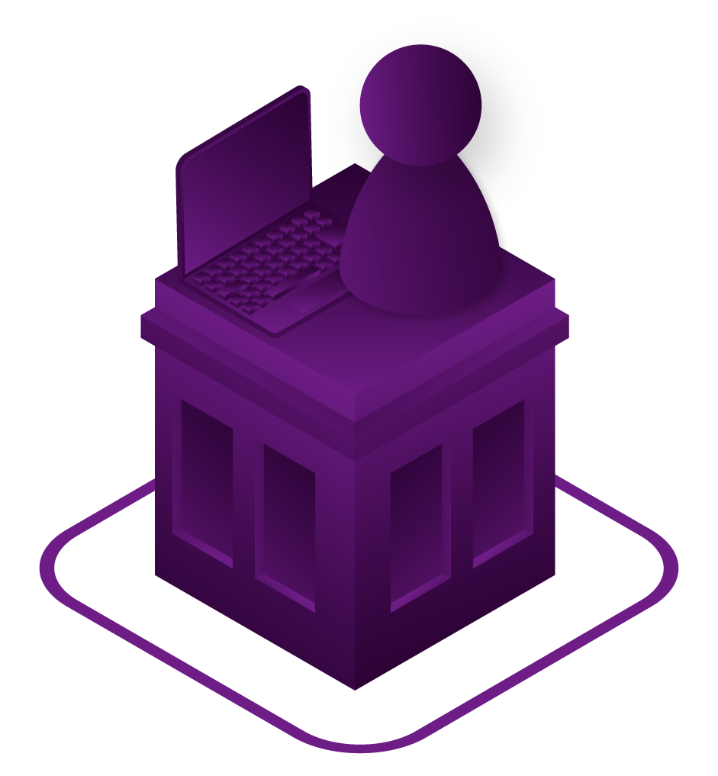
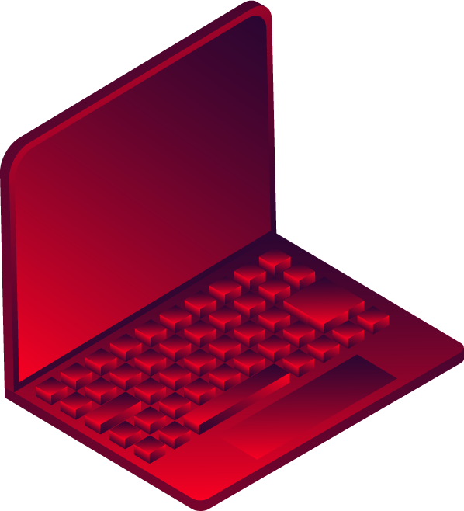

Our Offices Are No Longer
Where We Do Business
With business apps now in the cloud and prevalent high-speed Internet access, remote working is on the rise.
Our teams can work flexibly around family commitments. Reducing stress, avoid time lost time in commuting and overall helping to support mental wellbeing.
UK Businesses are downsizing office space and implementing desk-sharing policies to reduce overheads.
61%
of UK companies had
a cyberattack in 2019
Notes:
This one is around Location and flexible working times…
“Teams now need to work flexibly around family commitments. This reduces stress, avoids time lost in commuting, and overall helps to support mental wellbeing”

Slide 3
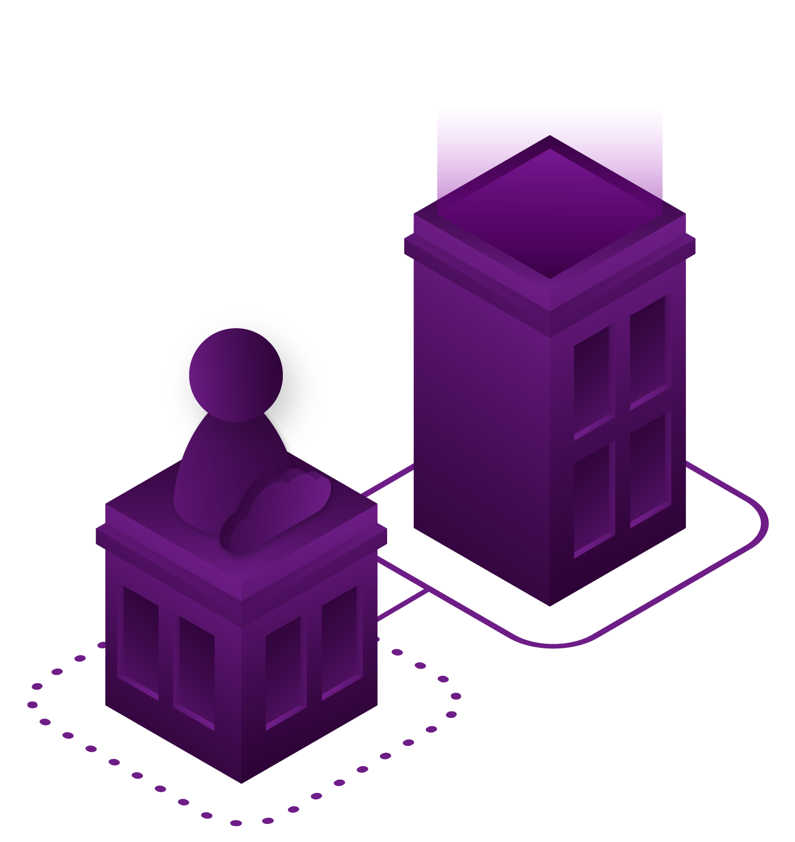

The way we work has changed
Every day our teams are using multiple devices to work with their colleagues and customers. We spend less time sitting at fixed locations on desktop devices, the office is no longer the single place of business
We use Cloud based SaaS apps and collaborate with HD Video calls, instant messaging and file sharing.
COVID has enforced home working, but it is here to stay in one form or another
81%
of workers expect to work from home at least one day a week post lockdown
70%
of employers will expand or introduce working from home on a regular basis
Notes:
How we work

Slide 4
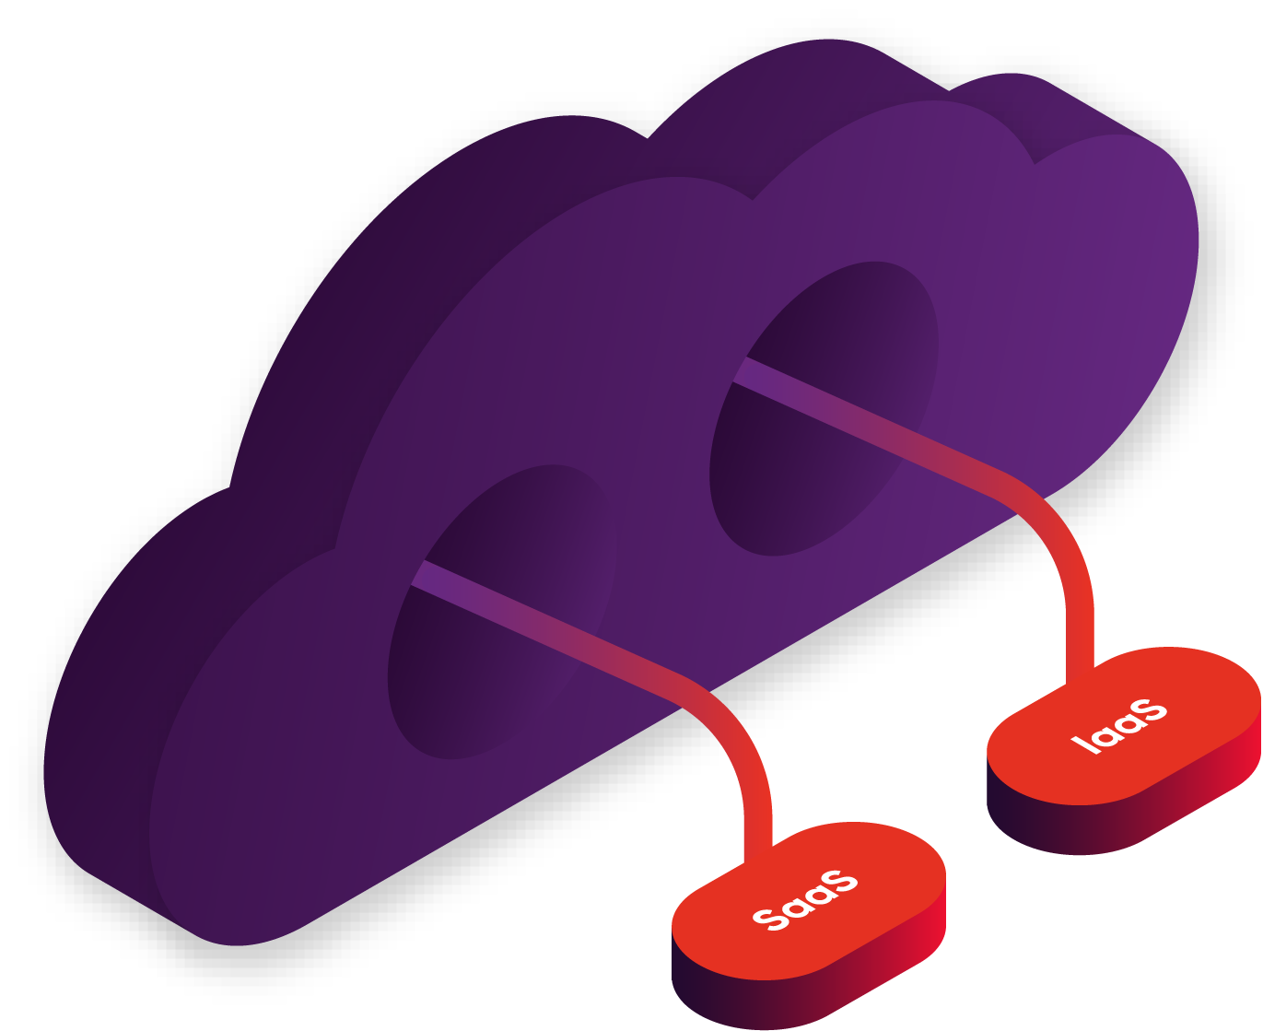

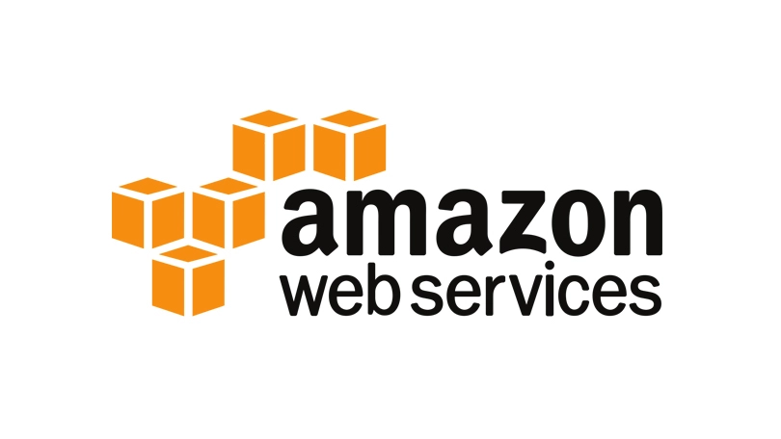

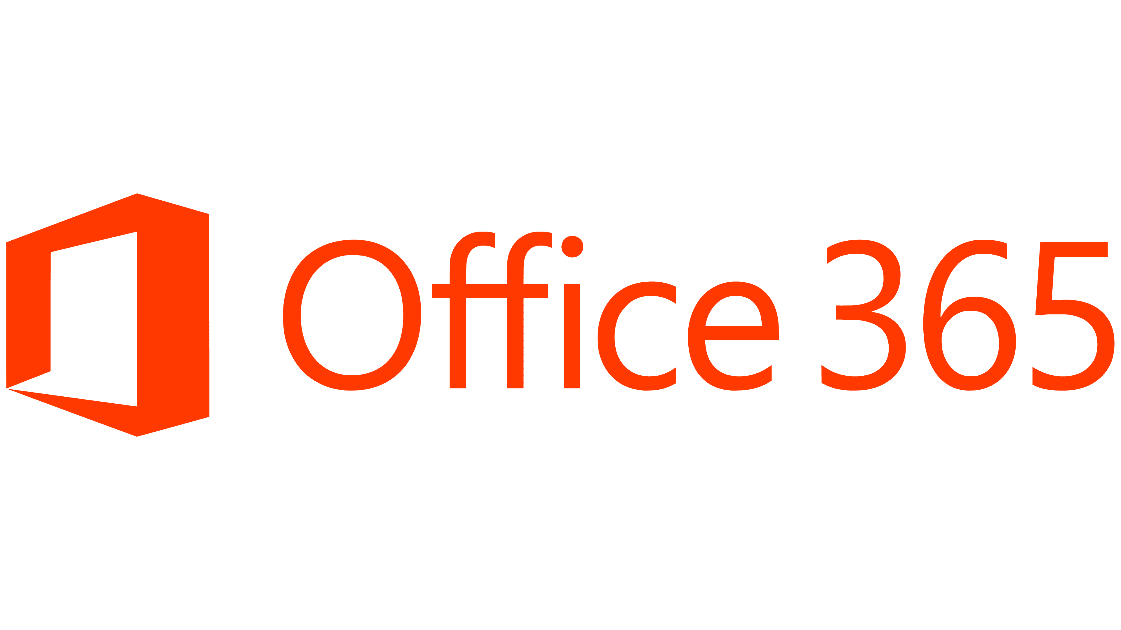
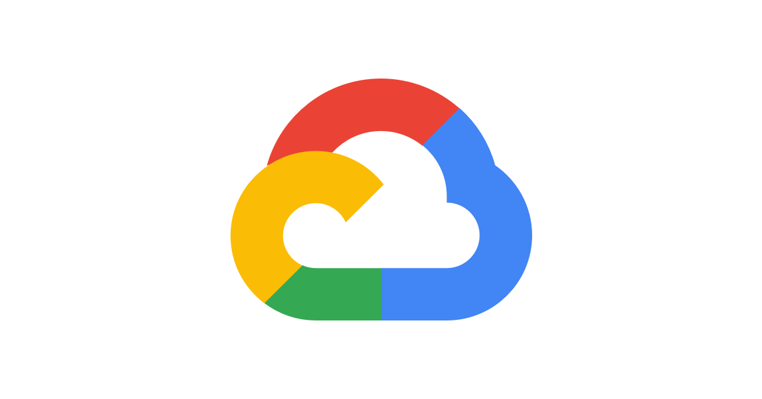



Our Business Data Isn’t Where It Used To Be
The trend of moving data and applications off-premise and into the cloud continues. Whether that's public
cloud from AWS, Google or Microsoft.
Businesses are continuing to place their data
off-site which is changing what they need from
their WAN solution
How do we control security and end-to-end performance?
Notes:
Where the data and apps are stored has moved.
Need to make the point about two types of move to cloud:
Moving existing on prem servers and applications to the cloud to be hosted as IaaS
Switching to use SaaS applications

Slide 5
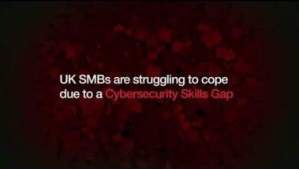

Virus and Malware Impact
Over half of UK businesses have fallen victim to Cyberattacks or security breaches in the last 12 months. It's not just large enterprises who are being targeted;
68%
of small UK businesses
75%
of large UK businesses
57%
of charities with income over £5 million
In addition the reputational brand and trust damage can have long term impacts which are difficult to put a financial number on.
Notes:
cAt FourNet we recognise that over the last few years the traditional network perimeter Firewall is not fit for purpose in current business environments. Users within enterprises want to work from anywhere, on any device, using applications that are distributed across enterprise data centres and many different types of cloud. This means that our customer’s critical data now traverses many ‘network edges’ which introduces new ways that threats can access the IT estate. Traditional security solutions cannot keep up as they can only deal with a single network perimeter.

Slide 6
Security is the Priority
Digital transformation is key to modern business success, but we cannot overlook the foundations. Firstly business data needs to be secured, and accessible to our teams wherever they are working.
In a recent survey, Gartner identified that 72% of businesses confirmed that security is the number one concern when it comes to their network.
Data breaches can cause significant brand damage and lose the trust of our customers.
Secure Infrastructure
Notes:
So given the changes in where we work, our flexible hours, increase in devices that we consume business apps on and the diversity of the applications we access and where they are hosted…
This means that securing the data and devices we have, and the traffic that flows between them, becomes increasingly more challenging.
Include:
increased application demands
improved user experience
integrated security
drastic remote workforce expansion.

Slide 7

Converged Requirements
Notes:
Persona - Replace with rebranded content done for AI & Automation whitepaper

Slide 8
FourNet Secure Infrastructure Portfolio
FourNet
Agile Cloud
Agile Cloud brings the Secure Infrastructure Portfolio together
Cloud Management & Analytics (AI and Machine Learning Driven)
Easily add UC and CC
services to Secure Fabric
24/7 NOC and SOC
Cyber Essentials + and
ISO 27001 Certified
Multiple UK based Tier
4 Data Centres
Next
Generation WAN
Security
Fabric
Enterprise
Networking
Software Defined Network
MPLS / DIA and Hybrid
Proactive Monitoring
Carrier and Technology Flexibility
Next Generation Firewalls
SD-WAN
Centralised Management
Deep Analytics
Automated Remediation
Campus & Data Centre Wireless & Wired Networks
Simple, cost-effective licensing
Subscription options

Slide 9
SD-WAN from FourNet
Your business needs a secure, flexible network foundation that can adapt as your business needs change over time. SD-WAN provide more control over applications and security than traditional network deployments.
Security
Protect from Internal and External threats
Application Performance
Accelerate your mission critical apps and block unauthorised applications
Insight
Deep analytics help you see how the network is supporting your business growth
www
www

Slide 10

Security
Protect from Internal and External threats with advanced security and intelligence.
With SD-WAN, every location is equipped with a Next Generation Firewall. Now we can protect against virus and malware threats from inside the organisation as well as outside. We can stop the spread of malicious programs throughout the business.
The application detection engine can also identify unauthorised applications on the network and block them.
All security policies are managed centrally from a single dashboard so it's easy to manage and report on compliance.
Notes:
What about ZTNA agent (FortiClient – remote workers)

Slide 11
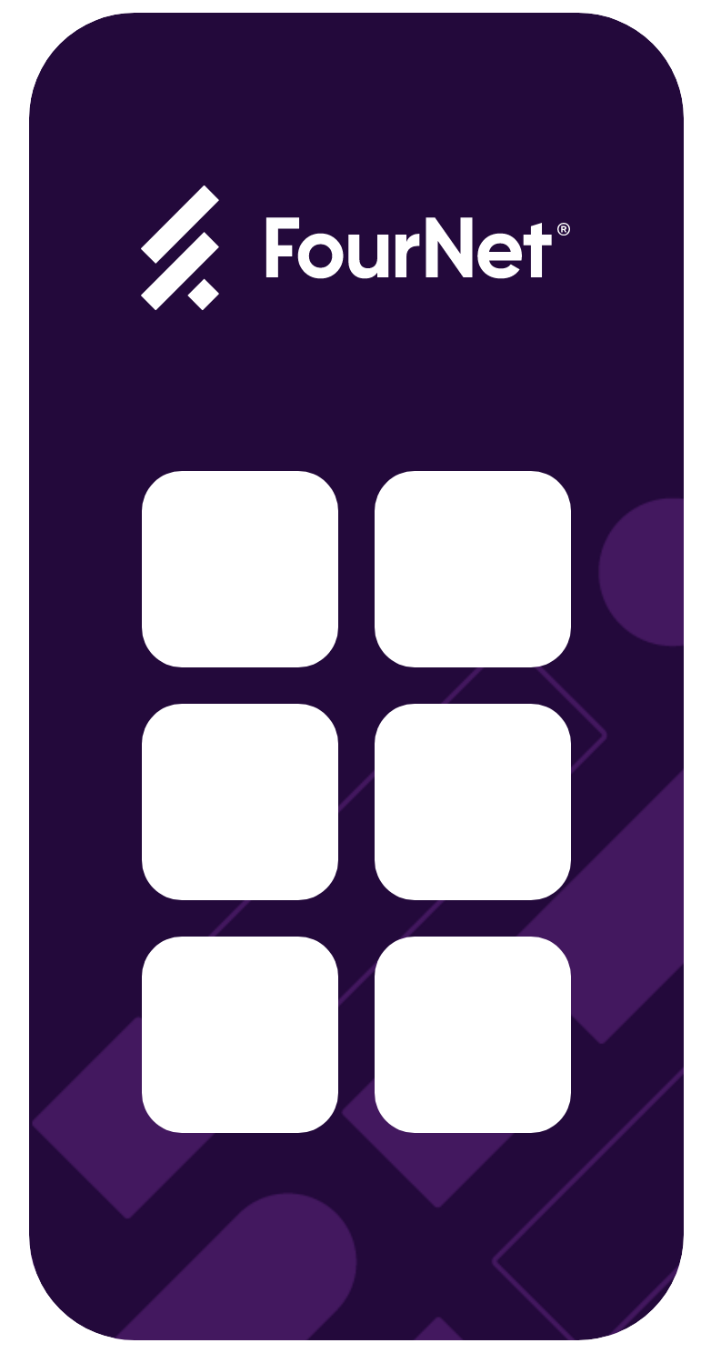
Application Performance
SD-WAN can automatically identify and prioritise over 3000 business applications providing an optimised experience for everyone.
The network adapts to your goals ensuring that the applications provide the best experience every time.
You set the priority that's important to your business.
SD-WAN can also mitigate security risks by identifying unapproved software applications running on the network and blocking their access.
We can choose the best network path for traffic to optimize bandwidth and save money. Also prioritize voice and video traffic
Notes:
Add that we can choose the best network path for traffic to optimize bandwidth and save money. Also prioritize voice and video traffic

Slide 12

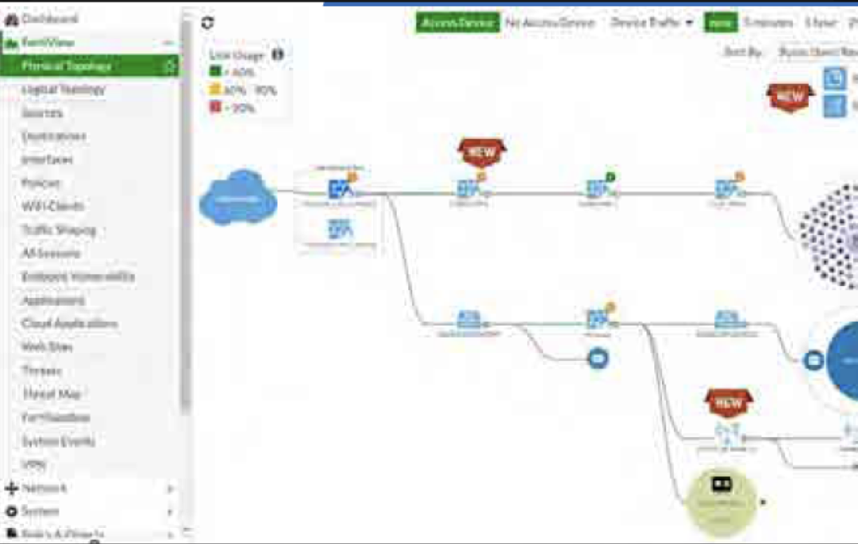
Insights and Analytics
Gain full insight into your business applications and track the changing needs of your organisation. Analyse metrics to ensure that teams get the performance they need, when they need it.
Identify risks, security threats and Shadow IT applications.
All of these analytics are hosted centrally in Agile Cloud and connects back to FortiLab services for AI Driven automated remediation
30%
of business technology spend is Shadow IT
Notes:
Add that all of these analytics are hosted centrally in Agile Cloud and connects back to FortiLab services for AI Driven automated remediation

Slide 13


Traditional MPLS
Networks
Partner
A typical MPLS network has two key features
Each site can communicate freely with every other site
Internet access is centralised through one single site at the head office location
Branch
Firewall
Untrusted
Apps
Private WAN
HQ
Internet
Branch
Notes:
However as businesses have evolved, more and more of our teams are using Internet based SaaS apps. This means that tunnelling all the traffic through a single head office location can cause congestion on the network.
Additionally, as security threats have evolved, phishing attacks are responsible for over 80% of intrusions in UK organisations. In an MPLS network, there is little to stop this spreading across all locations. Security and filters are only applied to traffic between the Head Office and the Internet.

Slide 14
SD-WAN
is different
Moved to Cloud
Partner
With SD-WAN, every location has a fully capable Next Generation Firewall (NGFW) on-site. Providing Advanced Firewall Services
such as;
Internal and External Threat Protection
Web Content Filtering
Application Acceleration
Malware detection and blocking
Branch
Firewall
Access
Untrusted
Apps
Private WAN
HQ
Internet
Shadow
IT
Branch
Work from Home
Notes:
Now we can directly connect these sites to the Internet as well as the Head Office and automatically prioritise, and secure every application experience.
In this design, should a phishing attack occur it would automatically be contained to one single site. The specific device would be quickly be identified for action to be taken.

Slide 15
Creating your
SD-Branch
Apps
Security and Acceleration Everywhere
Our Secure SD-WAN Solution doesn’t
stop at the edge.
Internet
Work from Home
Notes:
With high-speed LAN switching and Wireless Access Points, we can bring the same level of insight, security and application experience wherever you are working inside the building.
Forticlient client protects each computer and mobile device from virus and malware attacks while enabling secure web browsing.
Everything is still managed and reported centrally so you have a single pane of glass to understand what's happening at all times.

Slide 16
Get in touch
Notes:
So, in conclusion, you’ve seen
how our portfolio has massively expanded over the last few years, and
how we want to evolve the portfolio strategy going forward so it works for all of us!
It’s also fair to say that this approach isn’t set in stone, FourNet are always open to suggestions and the more buy in we all have into what we sell and why – the happier we’ll all be.
Thanks for indulging me, enjoy the rest of the festivities (although let’s face it, it will be downhill from here! ☺)

