Slide 1
The Modern Network
Performance and Security to
Empower Innovation

Slide 2


What We Will Cover
How The Landscape Has Evolved
The challenges we now face & the opportunities these create
Panel Discussion
What do we think the future will bring?
Question and Answers

Slide 3

CX
XCaaS
Managed Services
Cloud, Communication, Collaboration, Contact Centre
Secure Infrastructure
Managed Connectivity, Networking
Security

Slide 4






Meet Our Expert Panel
John Jones
Head of Solution Design
Dahwood Ahmed
Regional Director UK&I
Anish Chauhan
Director
Andy Napier
Product Manager
Chris Roberts
Business Development Manager

Slide 5











The Evolution of Comms - JJ
On Premise
Private Cloud
Public Cloud
Applications
Users' office based
Applications On Prem
Servers in DCs
IT Teams Managing OS
Agile Cloud: UC & CC!
SaaS to do our jobs
Bespoke apps in IaaS
Network
PSTN & Internet Circuits
(Slow)
MPLS & Private WAN
(Faster)
5G, Fibre, FTTP
(Super Fast!)
Corporate PCs
Wired LAN
IP Handsets
Wireless & BYOD
Remote Access
Softphones
Work from anywhere!
Web Browser
WebRTC
Users
Security
Perimeter Firewall
Unsecured LAN
Centralised Security
Network Access Control
Distributed SD-WAN
ZTNA

Slide 6

Number of
Connected Devices
In 2013

Slide 7

Number of
Connected Devices
In 2022

Slide 8


The Challenges We Face
X Huge Increase in Attack Surface
X Lack of Visibility
X Connected Devices / Internet of Things (IoT)
X Doing more with Less
X Speed of Deployment
X Organisational and Staff Expectations
X Sophistication of Cyber Threats
X Shadow IT
X Compliance Needs

Slide 9
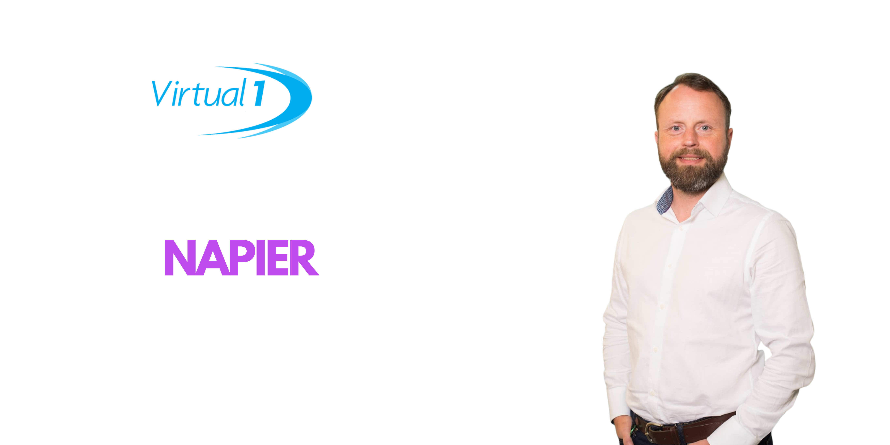



Slide 10


Slide 11


Slide 12


Slide 13
In Summary
Adding Value
Agile Cloud is designed with future challenges in mind:
Application Layer Experts – ‘turn on’ UC & CC
Proud of our People (CISSPs, Security Cleared, CCSKs)
Cloud Management & Analytics (AI and Machine Learning Driven)
24/7 NOC and SOC
Cyber Essentials Plus and
ISO 27001 Certified
Next-Gen Networking
Best of Breed Security
Evolution of Compliance
Software Defined Network
MPLS / DIA and Hybrid
Proactive Monitoring
Carrier and Technology Flexibility
Simple, Intuitive & Consistent
Next Generation Firewalls
SD-WAN
Centralised Management
Deep Analytics
Automated Orchestration & Remediation
Evolved Penetration Testing
Attack Simulation following the Cyber Kill Chain
Notes:
Summary
Before we go into Q&A it’s worth bringing all of this together from a FourNet point of view, we feel we’ve already got a HEAD START on everything we have discussed with our ‘Secure Infrastructure’ proposition.
Our cloud platforms are mature and have been designed and built from the ground up working closely with our PARTNERS who are here today.
(Next-Gen Networking)
We use EXTREME FABRIC TECHNOLOGY between our data centres for
Instant fault tolerance
Secure stealth networking
Speed of Customer Provisioning
VIRTUAL 1’s Software Defined ‘UNDERLAY’ network provides
the core that connects out to our customers using the technologies that is right for them
ensures we are on-net to other services we need such as Public Cloud platforms and SIP providers.
(Best of Breed Security)
FORTINET’S portfolio provides our customers with a Zero Trust approach to security and not to forget the SD-WAN ‘OVERLAY’.
We have also stood up
Multi Tenant Firewalls
Centralised management, analytics
other advanced services that use techniques such as AI and Machine Learning.
XXXX add here from Chris Slides
These services are ready as we speak in Agile Cloud for our customers to leverage.
(Evolution of Compliance)
EQUILIBRIUM’S third-party assessments and testing assures that we remain compliant.
(FourNet Value Add)
We also ADD TREMENDOUS VALUE to all of the partner technology that we have in portfolio.
Don’t forget FourNet have always DONE THE APPLICATION LAYER VERY WELL. Unified Comms and Contact Centre is our BREAD AND BUTTER after all, so we understand that ultimately the PERFORMANCE OF OUR SERVICES & USER EXPERIENCE are always the key drivers.
We have a 24/7 SERVICE DESK that proactively monitors and provides assurance to our customers.
Finally, we live and breathe this stuff! Our staff are SECURITY CLEARED to the highest levels, and as well as countless VENDOR ACCREDITATIONS we ensure we have more generic badges like CISSP and CCSK.
So we urge you to use our KNOWLEDGE, our PARTNERS and our CLOUD PLATFORMS to help you on your own Secure Infrastructure Journey!

Slide 14
Q&A

Slide 15


Thank you for your time!

