Slide 1
Digital Transformation for a new era
September 2022

Slide 2
Evolution of Cloud and FourNet Roadmap
Stuart Williams
Chief Technology Officer

Slide 3

CX
XCaaS
Managed Services
Cloud, Communication, Collaboration, Contact Centre
Secure Infrastructure
Managed Connectivity, Networking
Security

Slide 4
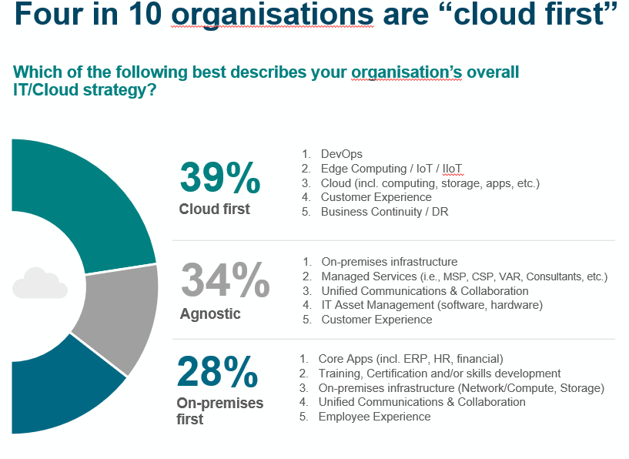

What’s Happening in the Market
Four in ten organisations are "Cloud First"
Source: Computer Weekly Research

Slide 5
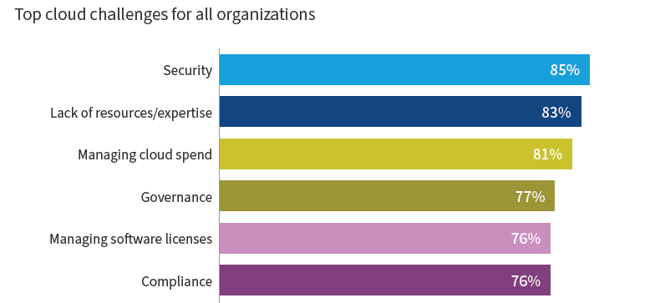
Cloud Challenges
Source: Flexera State of the Cloud 2022

Slide 6
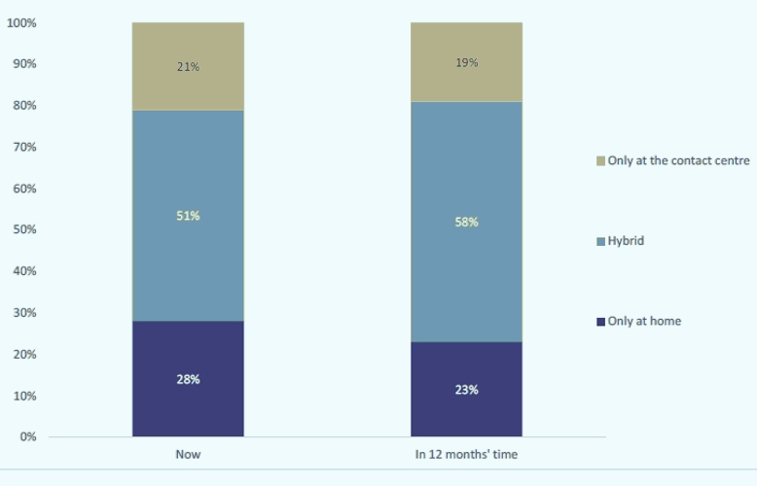
Hybrid Working Driving Adoption
Source: Contact Babel - CX Decision Makers Guide

Slide 7

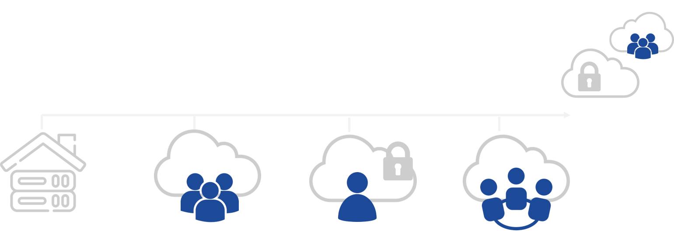

Types of cloud
Hybrid Cloud
On-Premise
Public Cloud
Private Cloud
Community Cloud
Scalability/Elasticity
Cost efficiency and flexibility
Shared infrastructure
Broad Network Access
Total Control
Bespoke Security
Fully Customisable to customer specific needs.
Shared by associated organisations, e.g. Central Gov, Local Gov, Health

Slide 8
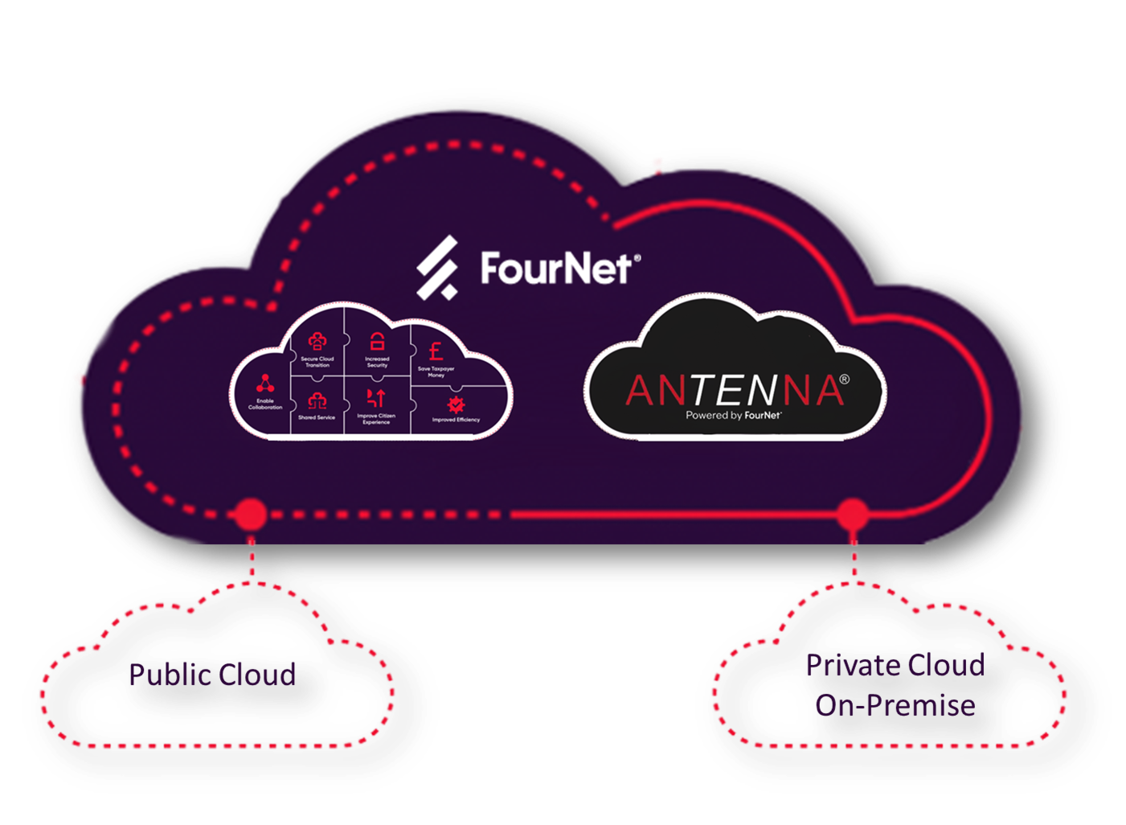
Cloud Services
Community Cloud

Slide 9

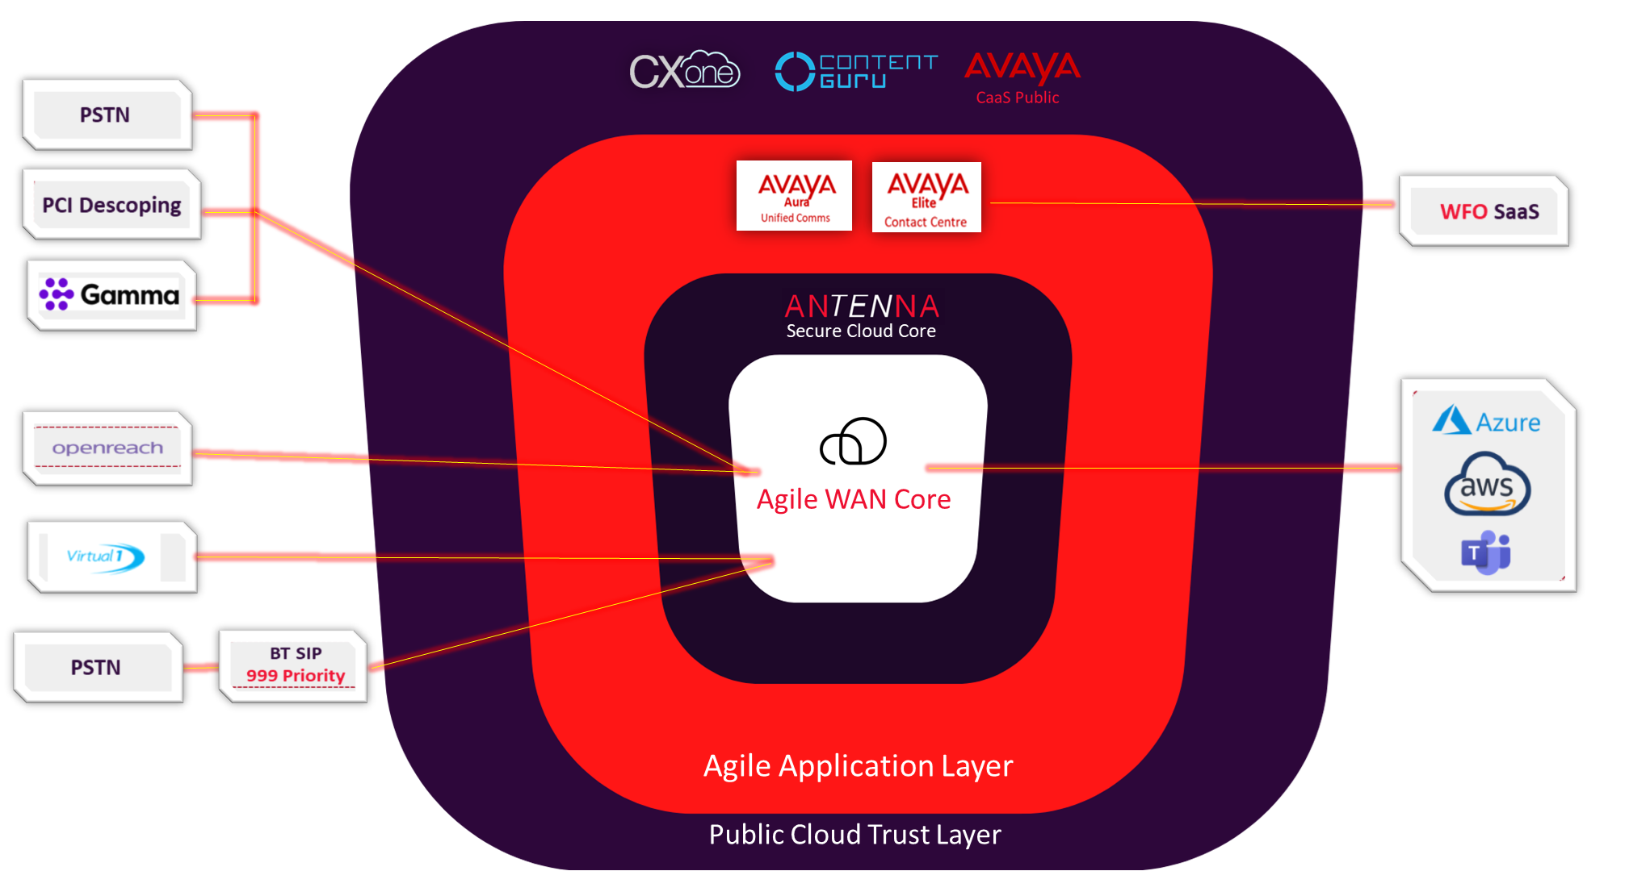
Agile Cloud Topology

Slide 10


Slide 11
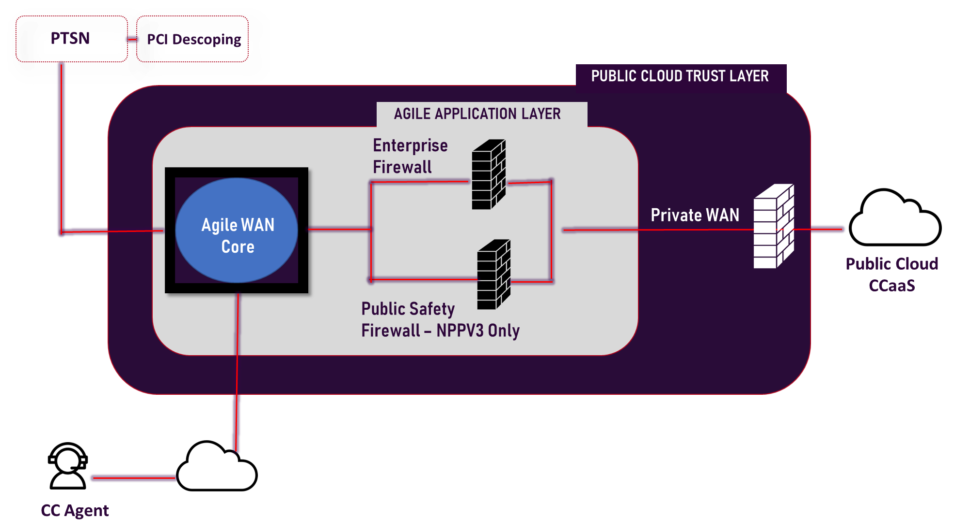
Public Cloud Partner Security
Sits Within
Public Cloud Trust Layer

Slide 12


Connectivity options
Internet – Via Secure Internet Edge
Agile WAN peered with customer WAN at shared DC
Agile WAN peered with customer
WAN at shared DC
Bring your WAN to Agile
FourNet PoP, ARK Corsham and Farnborough for Cross-Connect to Crown Hosting.
FortiGate SDWAN over FourNet provided DIA

Slide 13










Agile Cloud Cyber Security
CREST Accredited IT
Health check
PCI-DSS Descoping
SAQ/AoC
FortiGate Next Gen Firewalls
controls traffic ingress/Egress
Intrusion Protection System IPS, DDoS Protection Options; FortiDeceptor, FortiSandbox.
Vulnerability Scanning
and remediation programme
Cyber Essentials Plus
FortiGate SDWAN over
FourNet provided DIA
ISO27001 Controls.

Slide 14

ANTENNA Cloud Cyber Security
SC/DV
Cleared Engineers
UK Gov
Data Centres
Cabinet Office
Security Policy
Framework
Managed DDoS
Edge Defence
NCSC Cloud
Security Principles
CSA V3 Controls

Slide 15

Agile Cloud Functionality
Agile Cloud and ANTENNA have shared functionality and connectivity to all higher order services.
  Teams Direct Routing
  - Gamma SIP trunks, inc. STCM Business Continuity Platform
  - FourNet AIR records SIP and Teams Endpoints
  Avaya UC Core
    Desktop Handset, can short-dial Teams endpoints.
  FourNet UC Hybrid
    Desktop Handset, integrated with Teams, both devices share DDI, resilient to Teams outage.
  FourNet UC Power
    UC Hybrid with Voice Conferencing
  FourNet Mobile
    Agile registered Mobile, Powered by EE, shares DDI with Desktop handset and Teams
    Voice recording, analytics and web content-filtering.

Slide 16

Agile Cloud Functionality
  Voice Contact Centre
    Avaya Elite Contact Centre, inc. CMS Geomant Wallboards
    Premise or SaaS Verint WFO
    Calabrio SaaS
    FourNet AIR Recording and QM
  Omni-Channel Contact Centre
    Public Cloud Partners
  Analytics
    Partnered with Tiger allows us to provide analytics on all SIP and Teams environments
  Monitoring
    Partnered with Virsae, enhanced with FourNet IP, the Agile platform has a powerful monitoring platform ensuring the resilience of customer NGNs right through to Hybrid Worker desktop issues. (see slide below)

Slide 17
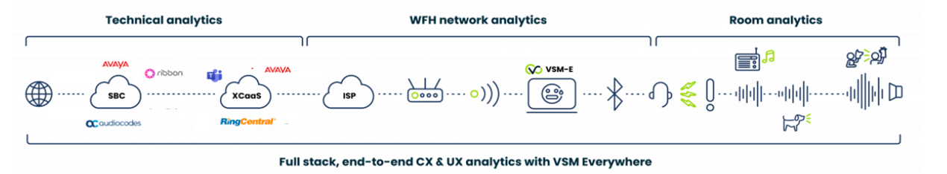

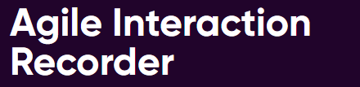
Recording Analytics & Monitoring
ESP Portfolio
FourSight : Diagnostic Dialler
Notes:
https://fournet.co.uk/solutions-and-services/agile-interaction-recorder/
https://fournet.co.uk/solutions-and-services/ucaas-analytics
https://fournet.co.uk/solutions-and-services/unified-communications-collaboration/

Slide 18
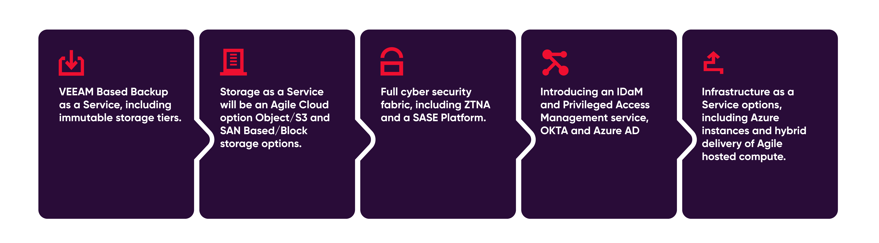
Our Agile Cloud RoadMap

Slide 19
Any Questions?

Slide 20
Thank you for your time!

