Slide 1
Digital Transformation for a new era
September 2022

Slide 2
Introducing Oliver Bareham

Slide 3

Transforming Your CX With Data

Slide 4


Oliver Bareham
Carphone Warehouse – Agent & Team Leader
Founded Mobile Development Consultancy
Last 7 Years at Capita – CX Transformation Consultancy Director
Customer Service – Front Line
Business Transformation – Technology through smartphones
Contact Centre Transformation – People, processes & technology
Customer Experience Director – FourNet
  Supporting our customers on their digital transformation journeys

Slide 5

CX
XCaaS
Managed Services
Cloud, Communication, Collaboration, Contact Centre
Secure Infrastructure
Managed Connectivity, Networking
Security

Slide 6
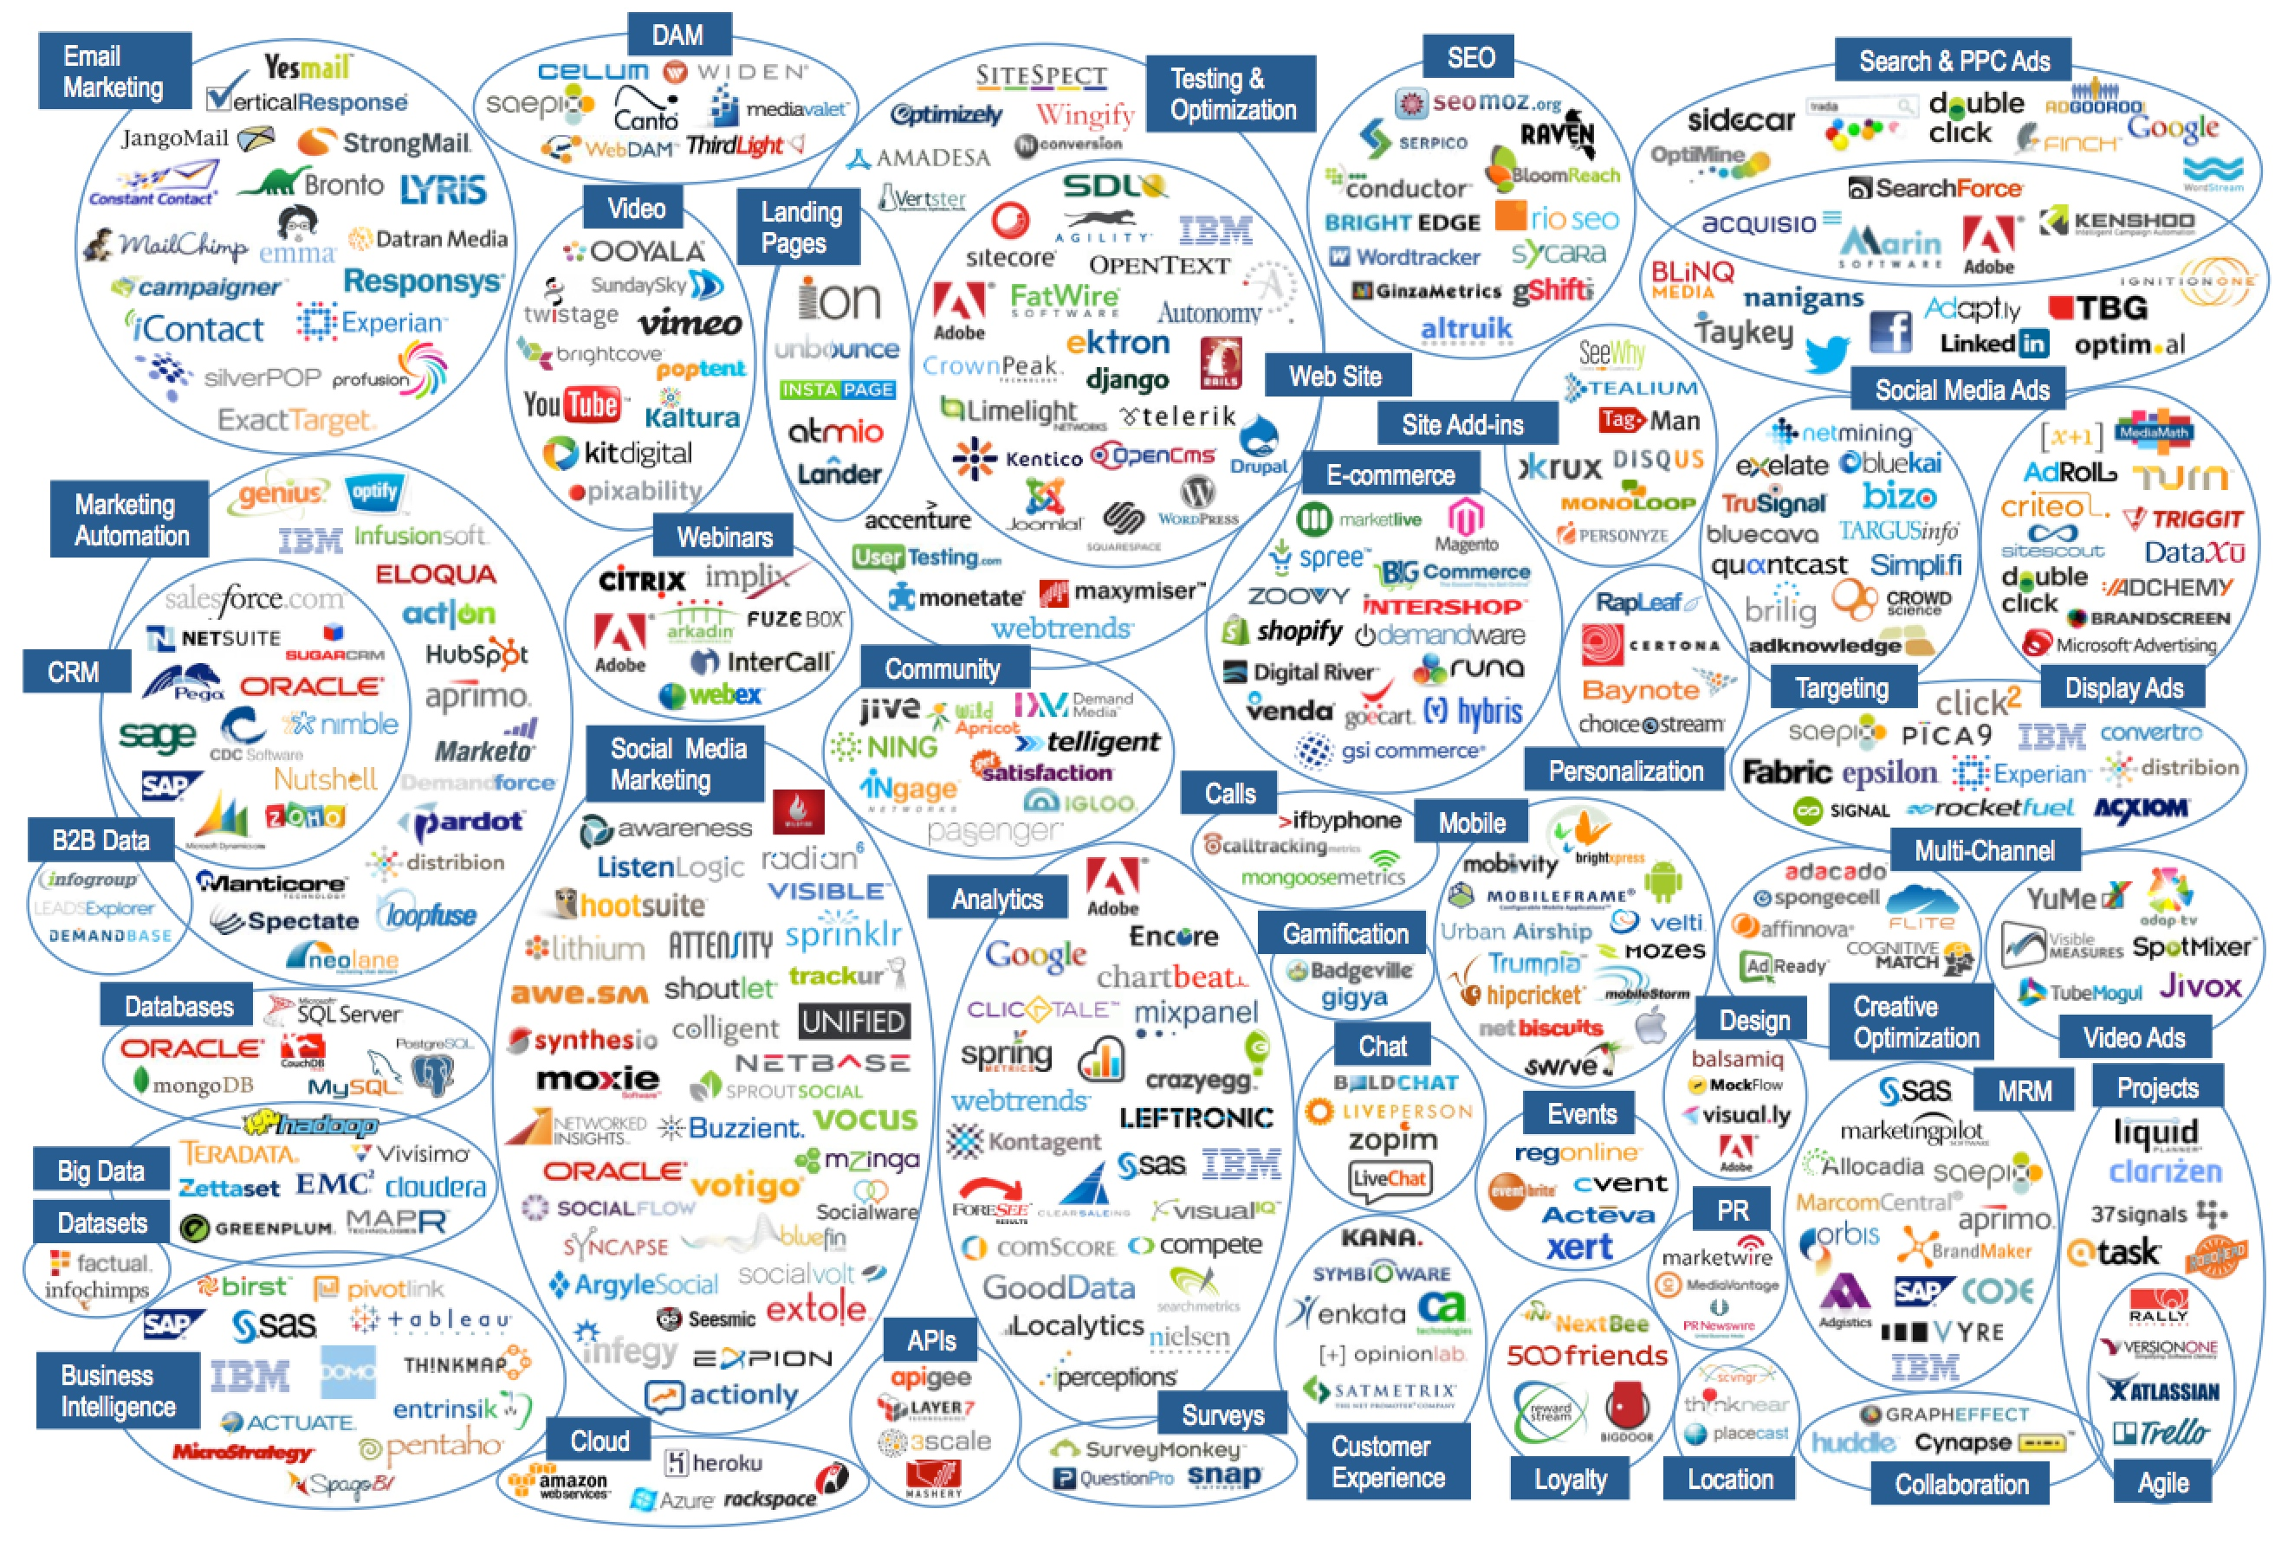

Slide 7
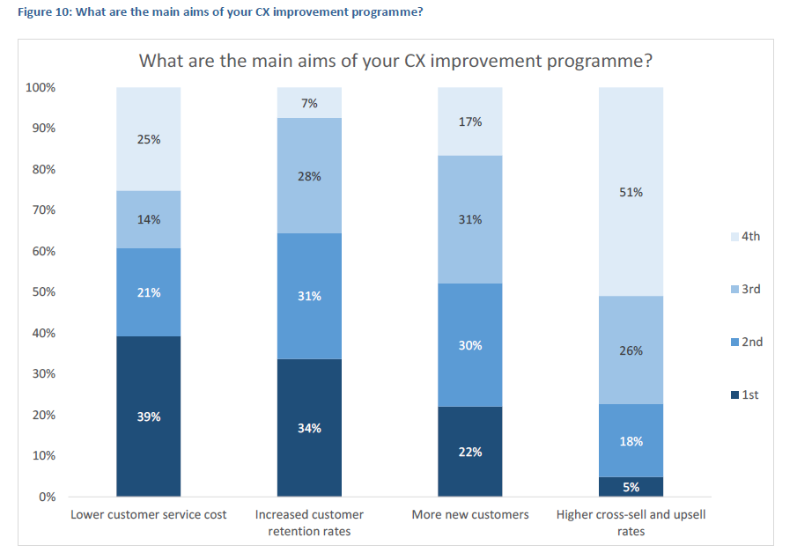






Why transform?
Source: ContactBabel

Slide 8
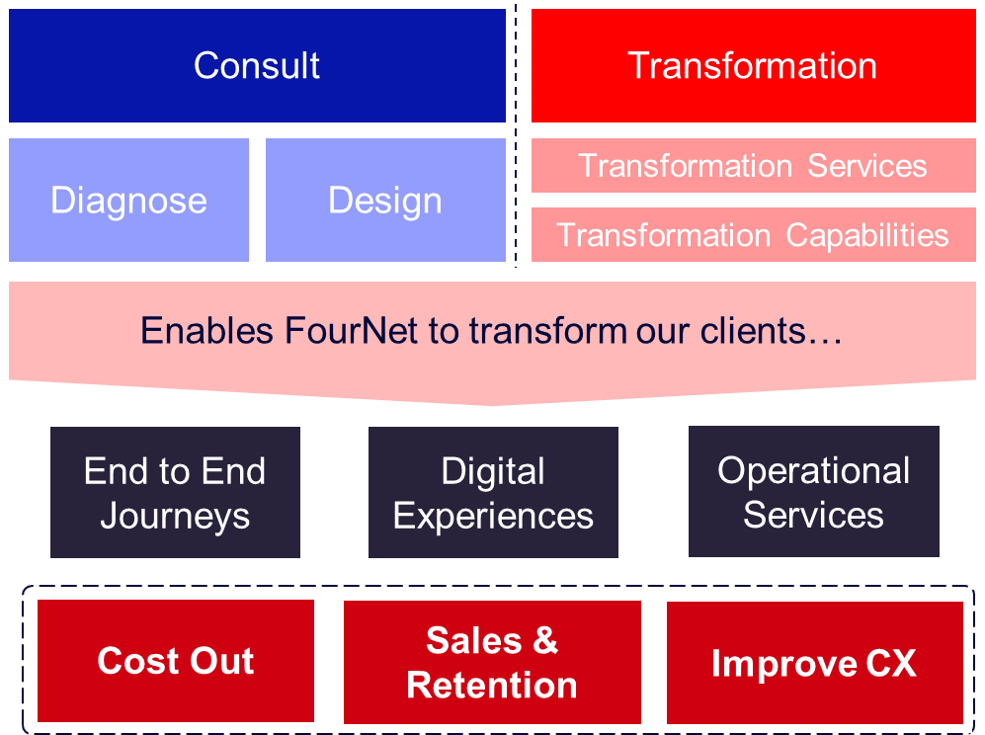
So, what do we do?

Slide 9
What do we do
Solving client business problems
Improved customer experience
Grow customer revenues & productivity
Lower cost-to-serve by reducing failure & increasing first call resolution
End-to-end experience management
Delighting Customers
More accessible, choice across multi-channel
Increased ease - right first time, every time
Increased loyalty and satisfaction (NPS scores)
P
R
O
B
L
E
M
S
D
E
L
I
G
N
E
S
S
H
T
I
N
G
B
U
S
I
C
U
S
I
N
G
T
O
M
L
V
E
R
O
S
S
Outcome focused
Making change happen
Lead in innovating across people & process
with technology
Commit to outcomes contractually
Partnerships create flexibility, evolving with your business
Amazing people
Developing highly skilled practitioners
Engaging and developing capability
Effective customer service agents with augmented technology
E
O
L
U
P
T
O
C
E
DELIGHTING
O
P
M
G
CUST
OMERS
E
N
D
I
Z
R
A
I
M
V
A
E
N
Insight led CX transformation
Channel optimisation through contact analytics
Applied data science, personalisation & optimisation to drive better customer outcomes
Partnerships to accelerate insight: Hypercube, McKinsey / Quantum Black
Digitally enabled
Insight-led optimisation of your digital assets
Building / introducing new assets e.g. integrated channel platforms
Adoption campaigns
I
N
S
L
E
D
I
G
H
E
N
A
B
T
L
E
D
A
L
L
Y
D
I
G
I
T

Slide 10
What do we do
Solving client business problems
Improved customer experience
Grow customer revenues & productivity
Lower cost-to-serve by reducing failure & increasing first call resolution
End-to-end experience management
Delighting Customers
More accessible, choice across multi-channel
Increased ease - right first time, every time
Increased loyalty and satisfaction (NPS scores)
P
R
O
B
L
E
M
S
D
E
L
I
G
N
E
S
S
H
T
I
N
G
B
U
S
I
C
U
S
I
N
G
T
O
M
L
V
E
R
O
S
S
Outcome focused
Making change happen
Lead in innovating across people & process
with technology
Commit to outcomes contractually
Partnerships create flexibility, evolving with your business
Amazing people
Developing highly skilled practitioners
Engaging and developing capability
Effective customer service agents with augmented technology
E
O
L
U
P
T
O
C
E
DELIGHTING
O
P
M
G
CUST
OMERS
E
N
D
I
Z
R
A
I
M
V
A
E
N
Insight led CX transformation
Channel optimisation through contact analytics
Applied data science, personalisation & optimisation to drive better customer outcomes
Partnerships to accelerate insight: Hypercube, McKinsey / Quantum Black
Digitally enabled
Insight-led optimisation of your digital assets
Building / introducing new assets e.g. integrated channel platforms
Adoption campaigns
I
N
S
L
E
D
I
G
H
E
N
A
B
T
L
E
D
A
L
L
Y
D
I
G
I
T

Slide 11
What do we do
Solving client business problems
Improved customer experience
Grow customer revenues & productivity
Lower cost-to-serve by reducing failure & increasing first call resolution
End-to-end experience management
Delighting Customers
More accessible, choice across multi-channel
Increased ease - right first time, every time
Increased loyalty and satisfaction (NPS scores)
P
R
O
B
L
E
M
S
D
E
L
I
G
N
E
S
S
H
T
I
N
G
B
U
S
I
C
U
S
I
N
G
T
O
M
L
V
E
R
O
S
S
Outcome focused
Making change happen
Lead in innovating across people & process
with technology
Commit to outcomes contractually
Partnerships create flexibility, evolving with your business
Amazing people
Developing highly skilled practitioners
Engaging and developing capability
Effective customer service agents with augmented technology
E
O
L
U
P
T
O
C
E
DELIGHTING
O
P
M
G
CUST
OMERS
E
N
D
I
Z
R
A
I
M
V
A
E
N
Insight led CX transformation
Channel optimisation through contact analytics
Applied data science, personalisation & optimisation to drive better customer outcomes
Partnerships to accelerate insight: Hypercube, McKinsey / Quantum Black
Digitally enabled
Insight-led optimisation of your digital assets
Building / introducing new assets e.g. integrated channel platforms
Adoption campaigns
I
N
S
L
E
D
I
G
H
E
N
A
B
T
L
E
D
A
L
L
Y
D
I
G
I
T

Slide 12
What do we do
Solving client business problems
Improved customer experience
Grow customer revenues & productivity
Lower cost-to-serve by reducing failure & increasing first call resolution
End-to-end experience management
Delighting Customers
More accessible, choice across multi-channel
Increased ease - right first time, every time
Increased loyalty and satisfaction (NPS scores)
P
R
O
B
L
E
M
S
D
E
L
I
G
N
E
S
S
H
T
I
N
G
B
U
S
I
C
U
S
I
N
G
T
O
M
L
V
E
R
O
S
S
Outcome focused
Making change happen
Lead in innovating across people & process
with technology
Commit to outcomes contractually
Partnerships create flexibility, evolving with your business
Amazing people
Developing highly skilled practitioners
Engaging and developing capability
Effective customer service agents with augmented technology
E
O
L
U
P
T
O
C
E
DELIGHTING
O
P
M
G
CUST
OMERS
E
N
D
I
Z
R
A
I
M
V
A
E
N
Insight led CX transformation
Channel optimisation through contact analytics
Applied data science, personalisation & optimisation to drive better customer outcomes
Partnerships to accelerate insight: Hypercube, McKinsey / Quantum Black
Digitally enabled
Insight-led optimisation of your digital assets
Building / introducing new assets e.g. integrated channel platforms
Adoption campaigns
I
N
S
L
E
D
I
G
H
E
N
A
B
T
L
E
D
A
L
L
Y
D
I
G
I
T

Slide 13
What do we do
Solving client business problems
Improved customer experience
Grow customer revenues & productivity
Lower cost-to-serve by reducing failure & increasing first call resolution
End-to-end experience management
Delighting Customers
More accessible, choice across multi-channel
Increased ease - right first time, every time
Increased loyalty and satisfaction (NPS scores)
P
R
O
B
L
E
M
S
D
E
L
I
G
N
E
S
S
H
T
I
N
G
B
U
S
I
C
U
S
I
N
G
T
O
M
L
V
E
R
O
S
S
Outcome focused
Making change happen
Lead in innovating across people & process
with technology
Commit to outcomes contractually
Partnerships create flexibility, evolving with your business
Amazing people
Developing highly skilled practitioners
Engaging and developing capability
Effective customer service agents with augmented technology
E
O
L
U
P
T
O
C
E
DELIGHTING
O
P
M
G
CUST
OMERS
E
N
D
I
Z
R
A
I
M
V
A
E
N
Insight led CX transformation
Channel optimisation through contact analytics
Applied data science, personalisation & optimisation to drive better customer outcomes
Partnerships to accelerate insight: Hypercube, McKinsey / Quantum Black
Digitally enabled
Insight-led optimisation of your digital assets
Building / introducing new assets e.g. integrated channel platforms
Adoption campaigns
I
N
S
L
E
D
I
G
H
E
N
A
B
T
L
E
D
A
L
L
Y
D
I
G
I
T

Slide 14
What do we do
Solving client business problems
Improved customer experience
Grow customer revenues & productivity
Lower cost-to-serve by reducing failure & increasing first call resolution
End-to-end experience management
Delighting Customers
More accessible, choice across multi-channel
Increased ease - right first time, every time
Increased loyalty and satisfaction (NPS scores)
P
R
O
B
L
E
M
S
D
E
L
I
G
N
E
S
S
H
T
I
N
G
B
U
S
I
C
U
S
I
N
G
T
O
M
L
V
E
R
O
S
S
Outcome focused
Making change happen
Lead in innovating across people & process
with technology
Commit to outcomes contractually
Partnerships create flexibility, evolving with your business
Amazing people
Developing highly skilled practitioners
Engaging and developing capability
Effective customer service agents with augmented technology
E
O
L
U
P
T
O
C
E
DELIGHTING
O
P
M
G
CUST
OMERS
E
N
D
I
Z
R
A
I
M
V
A
E
N
Insight led CX transformation
Channel optimisation through contact analytics
Applied data science, personalisation & optimisation to drive better customer outcomes
Partnerships to accelerate insight: Hypercube, McKinsey / Quantum Black
Digitally enabled
Insight-led optimisation of your digital assets
Building / introducing new assets e.g. integrated channel platforms
Adoption campaigns
I
N
S
L
E
D
I
G
H
E
N
A
B
T
L
E
D
A
L
L
Y
D
I
G
I
T

Slide 15
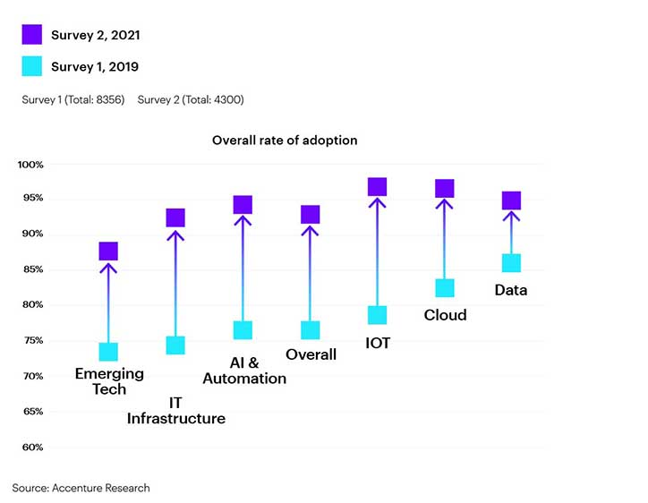
Why is CXT it important?
Covid-19 accelerated digital transformation by around seven years
2019 – 5G, IoT, blockchain, augmented reality
2021 – Digital security, cloud computing, workforce augmentation, AI & data

Slide 16
Transforming to your audience
Key technological advances and launches over the past 30 years have increasingly enabled digital services within the population.
Anyone 48 & under has lived with the internet their entire adult life
Anyone 33 & under has lived with smart phones their entire adult life
1992
First UK internet services
2007
First UK smart phones
2020
Covid-19 Landed
2000
First UK Broadband Service
2019
First UK 5G service
Anyone 40 & under has lived with broadband their entire adult life
Anyone 21 and under has lived with 5G their entire adult life
Even with an increasingly older, skewed population the number of people exposed to digital and with a high digital propensity continues to grow every year.

Slide 17
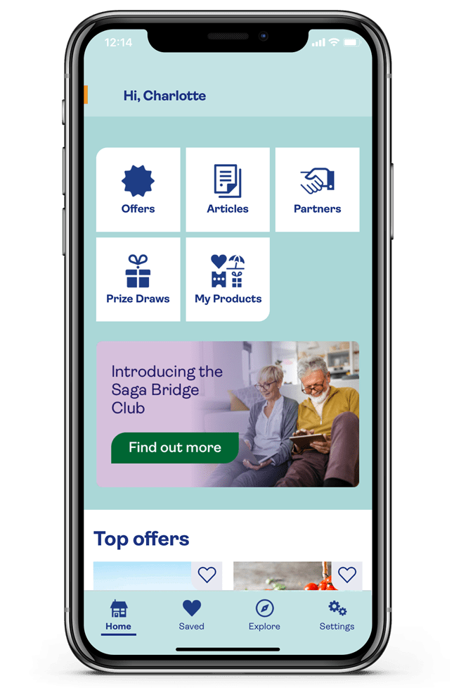
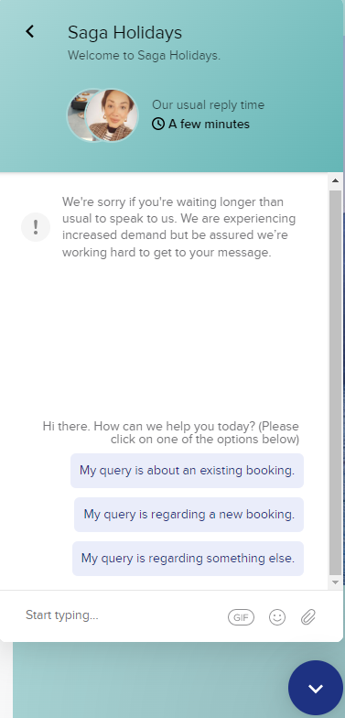
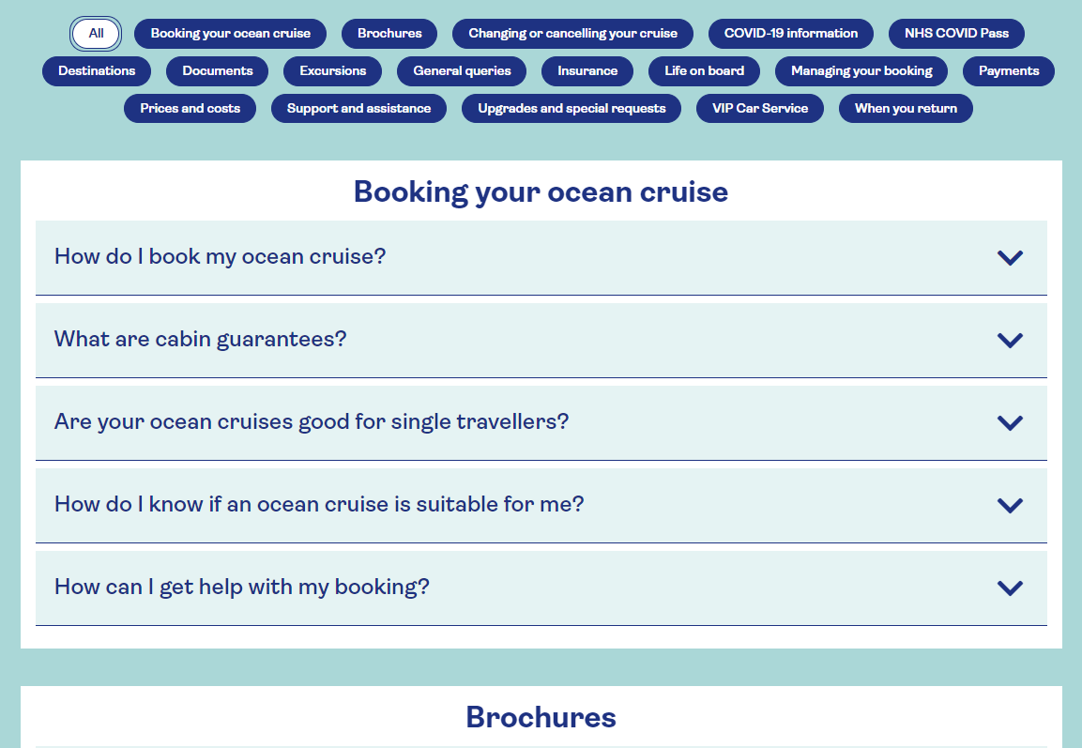
Saga Cruises
Over 50’s business (digital immigrants)
Driving digital through webchat
Phone line – confusing IVR
Pushing to download the app
8 different numbers to contact on
Call centre Monday – Saturday
Long and confusing FAQ section

Slide 18
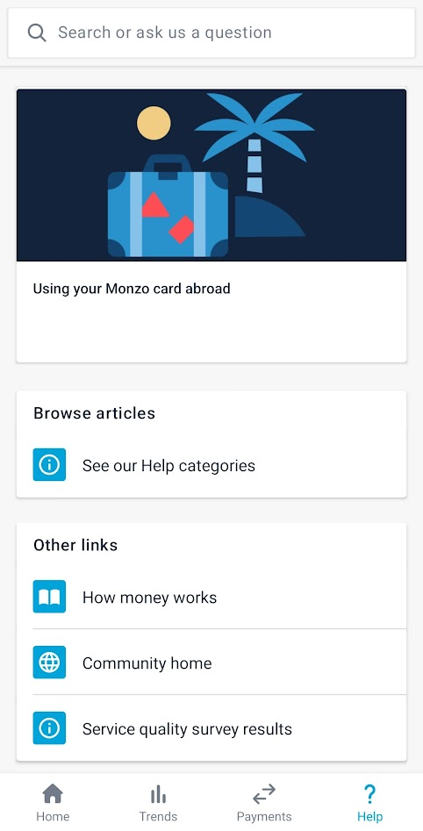
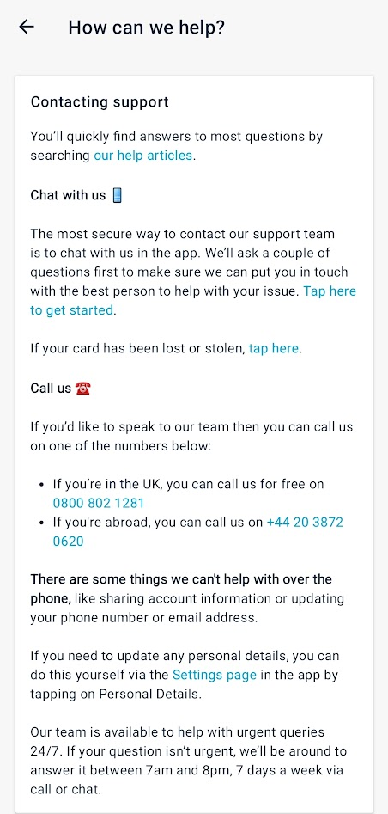
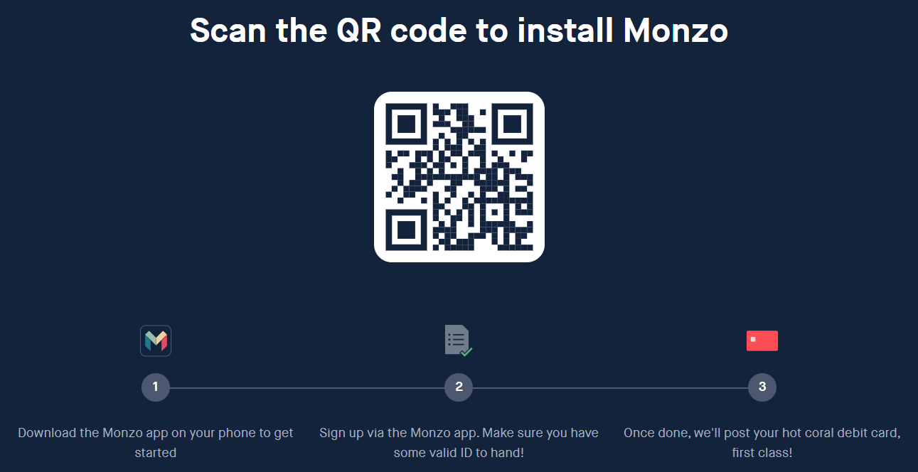
Monzo
Aimed at the 16 – 35 market (digital natives)
In-app banking only
Hidden chat facility for support
Community drive the support
All journeys require the app

Slide 19
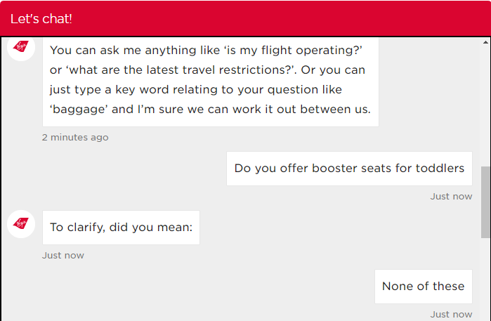
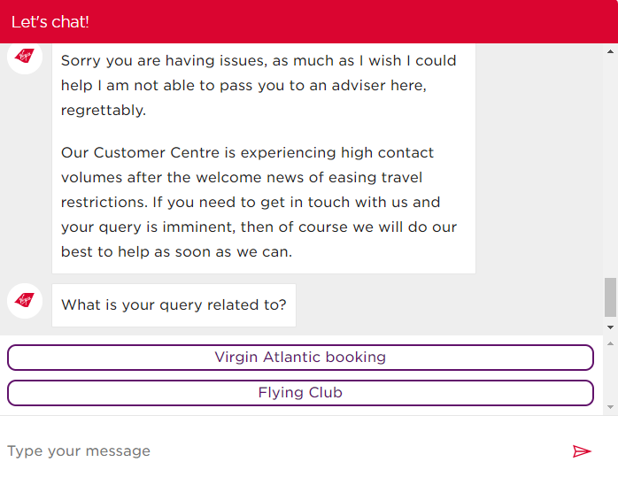
Virgin Atlantic
Aimed at 25-60+ (digital adopters)
Intuitive website design with simple instruction
Chatbot available within the help sections
When unable to answer question it is unable to hand off to a human

Slide 20
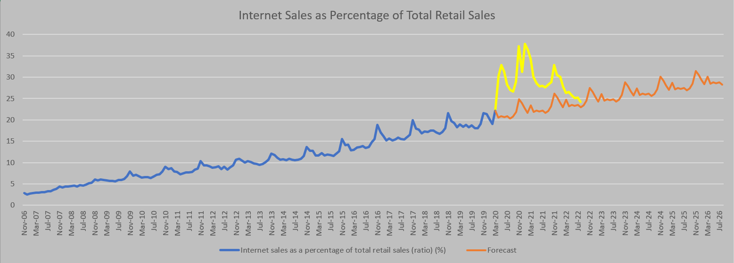
Internet Sales
Digital adoption in online sales has now reverted back to almost pre-covid levels.

Slide 21
Looking at the root cause

Slide 22
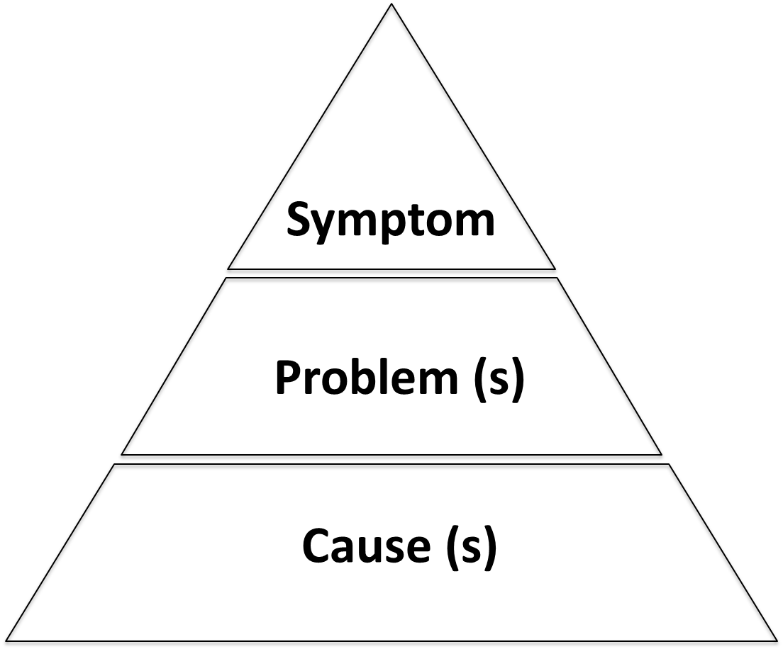
Why is root cause important?

Slide 23

Get into the data!
Customer – CRM
Employee – Tenure & attrition
Telephony – MI & BI
Chat & Messenger
Quality
Social media

Slide 24

Customer Data - CRM
Understand call drivers and narrow down root cause.
Without this it’s impossible to conduct root cause analysis.
Understand the contact drivers and which ones cause the most pain. Longest handle times, result in repeat contacts etc. (is this based on people/process/policy). Would certain contacts be better handled by a ring-fenced team of specialist agents?
Dependant on agent selecting the correct inputs (tendency to choose path of least resistance)
Notes:
Within the CRM you will have mostly quantitative data. Quantitative data is completely measurable and objective. This is specific to each individual customer – how many interactions, handling times, repeats, complaints, survey scores etc
Qualitative data should exist within your CRM, such as verbatim survey feedback, wrap up notes

Slide 25
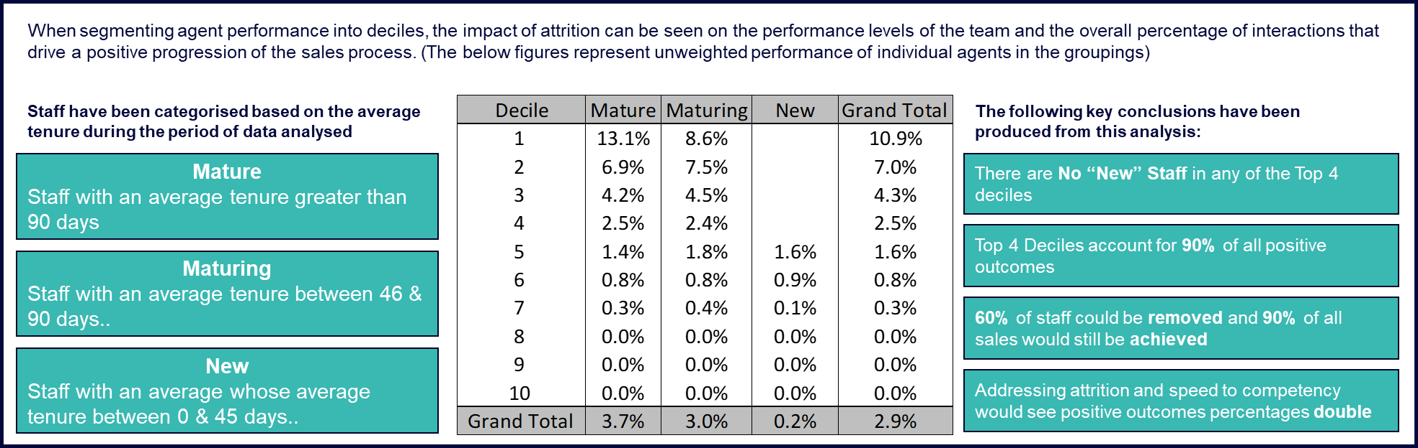
Employee Data
Identify the impact of tenure on AHT, CSAT, QA by outcome. If attrition is an issue it also allows you to look into the root cause
Savings on recruitment and training in most instances.
For example - Agents with tenure less than 90 days account for 80% of the AHT with the lowest CSAT and drive the most repeat contacts.
Notes:
This data comes from multiple sources – connected to show the community of agents, their tenure and associated performance metrics
The newer you are the more likely you are to score lower in surveys and longer AHT.
Tools, support, culture drive longer retention

Slide 26
Telephony Data
To understand when and what call volumes are coming in/going out based on IVR/VDN (options selected – path taken).
Using the CLI (call identifier) we can also then map a journey for each customer to identify where people/process/policy has failed, and the customer has had to make repeat attempts to resolve a query/complaint.
Limitations – Dependant on caller selecting the correct inputs (tendency to choose path of least resistance)

Slide 27
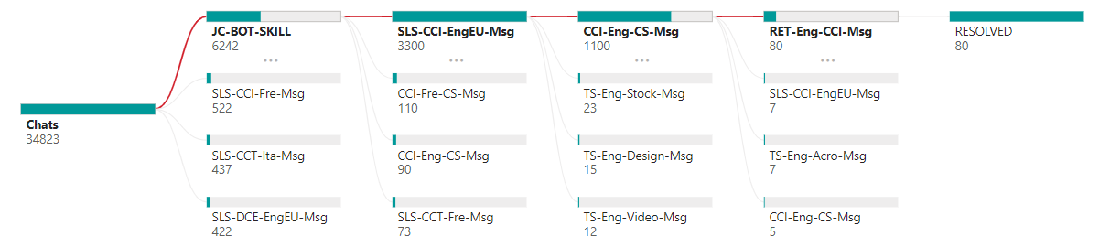
Chat & Messenger Data
Understand the contact drivers and where they originate from within your digital estate.
Longest handle times, result in repeat contacts etc. (is this based on people/process/policy).
Using text analysis helps identify the key topics and reason for contacts – propose updates to FAQs, website changes to improve useability and ensure key info is accessible to customers.
Limitations – Can be time consuming to tailor results to each business sector

Slide 28
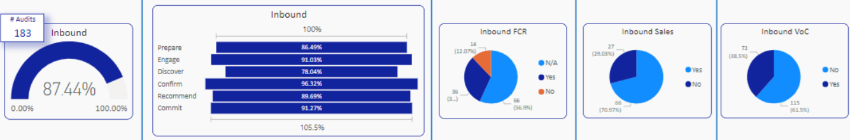
Quality Data
Identify issues in processes and the impact of these processes on AHT
One of the most valuable sources of customer experience data – when used correctly
When setting up your QA programme, the very first thing that you need to do is define what “quality” means to you and your customers
Full QA process needs to be understood, QA process is usually handled by a single team which can leave the scoring open to interpretation.
Good collection and understanding of QA data allows you to lift all aspects of CX including FCR, NPS & CSAT

Slide 29
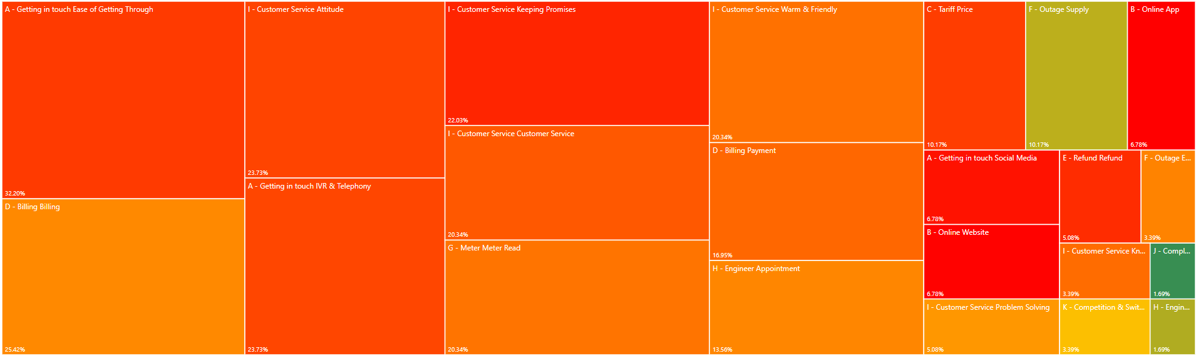
Social Media Data
Understand what customers are saying about you on social media
Uncover the key pain points customers are facing when engaging with your company
Limitations – Only Twitter data as others tend to be protected
Notes:
Valuable customer service channel to support digital transformation
Verbatim customer tweets outline the flaw in the journey
Sentiment analysis

Slide 30










On site diagnostic
Qualitative analysis
Spending time within the operation enables you to capture invaluable insights into what the teams do with specific engagements, as well as getting to see how they use the tools at their disposal.
The on-site review included:
Side by side listening with agents
Sessions with Team Managers
We were looking to understand:
The activity that takes place at each stage of the customer journey
Current challenges for the business
Opportunities where process changes, different staffing or technology could improve performance and experience in line with the objectives set out by the Senior Leadership Team
Review of the resources & process
Review of the tools used
Review of planning process
Outbound Sales
35 new customers per month
80 calls per day
25 perm, remainder contract
Salesforce: source of leads, soft phone access, lead nurture / development, CRM
Google Chrome: prospect research across all sources available
Trip Advisor: used to validate business info & suitability of prospect for targeting
Looker: business performance tracker, restaurant performance MI/BI
Slack: shared workspace tool
Gmail: inbound & outbound restaurant interactions
Google Sheets: prospect list, email templates etc
onfido: used to carry out KYC checks
Docusign used to manually send contract to customer via email for signing
Current process of calculating the number of staff required based on activity and demand volumes
Staff requirements carried out at individual task level (i.e. by team)
Performed using manual calculations and google sheets(?)
High level staffing profile of the Manchester & Madrid operations, indicative salaries
Individual task activity data (28/6-25/10 2021)
Team of 60
Inbound Sales
140 contracts per month.
Warm leads from website
Email with optional telephone contact
Team of 26
Onboarding
60 connected calls per day, QA @ 90%, 3hrs talk time
Responsible for getting customers to turn the tablet on & going live
Team of 26
Same target as installations
3 main tasks: Welcome to the Hub, 1 week review & day 21

Slide 31
Mapping your as-is
 | Absent | Informal | Standardised | Measured | Optimised
Processes
People
Technology
* Customer Journeys
* Employee Engagement
* Vision & Objectives
* Environment
* SLA’s
* QA Framework
* Channel Mix
* Contact Strategy
* Campaign Management
* Script / Call Guide
* Performance Management
* Incentive Schemes
* Planning / WFM
* Resources
* Recruitment
* Training
* Onboarding
* Compliance Monitoring
* Lead Targeting
* Powered Dialling
* Data Quality / Supply
* Webchat
* Lead Management
* Knowledge Management

Slide 32
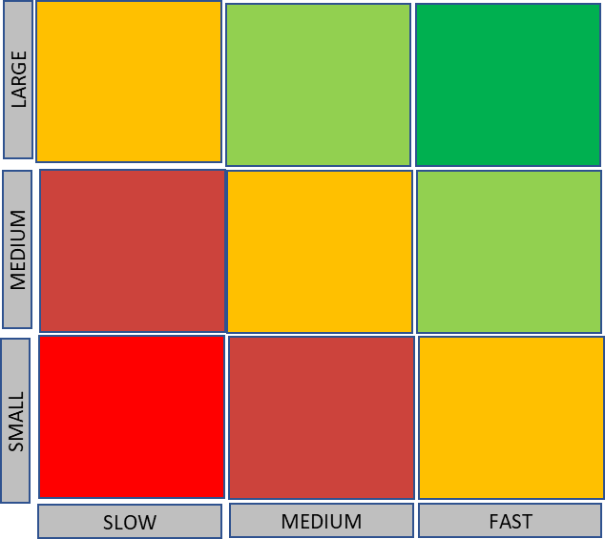









Solution mapping
Contact centre
Delivery Process
Onboarding Process
Active Client
Power dialler
Smart Source lead generation
Agent assist
Asynchronous messaging
Right time to call
Inbound calls accepted
Workforce planning model
Multi-skilled workforce
Automated response for all inbound email
Self-service installation
Sales lead to oversee installation
Asynchronous messaging
Inbound support tools
Conversational AI channels
Location & timed delivery of tablet
Conversational AI support channels
Asynchronous messaging
WhatsApp / SMS tools
Asynchronous messaging
Conversational AI support channels
Benefit unlock
Time to deliver
Notes:
Releasing the value to initiate the next part of the transformation (domino effect)
Prioritise the low hanging fruit

Slide 33
Transformation Strategy
There is a significant opportunity to take advantage of the many digital and AI-driven technologies that are being used to enhance both the customer experience as well as reduce the cost to serve for organisations.
By applying AI, digital channels and better use of data, the outbound sales agents can be much more successful with relatively less effort and the inbound demand can be almost eliminated.
Best In-Class Customer Contact Model
INBOUND
OUTBOUND Contact
INBOUND Contact
Customer Self-Serve
Automated Assistance
Voice
Digital Assistance
Website & customer portals designed to allow customers to access info and complete simple tasks without need for support
Data:
Source key account data systematically and dynamically through APIs
Enrich data with each contact
Restaurant Portal:
One stop onboarding: Self-serve sign–up, tablet installation
AI to populate menu with OCR
Non-human
Where support is required, AI-driven tools helps support the Customer without need for human intervention
Technology:
Powered dialler (Efficiency + Data)
Automated Voicemail
SMS for tactical contact containing inbound direct dial
Conversational AI:
Enhanced FAQ, triage and troubleshooting through intelligent conversational support available through multiple channels.
Reducing volume of contacts
More complex Customer queries or tasks can be supported through human support across multiple digital channels (Webchat, Social Media, Messaging etc) for effective resolution and customer channel of choice
Voice:
Automatically present call to agent with associated restaurant data
Confirm contact preferences (AM/PM/EVE – Voice or MSG)
Text Solution:
Replace the use of email completely
SMS/Messenger offered as contact channel of choice. (Higher ‘read’ rates / higher engagement)
Human
Where necessary, or if Customer prefers, the ability to speak to a live agent for complex, sensitive or high value interactions ensures the most costly channel is delivering the highest value to the business
Digital Conversations:
Ongoing communications via digital channels (Omni-channel)
Asynchronous messaging (SMS / Messaging Apps)
Voice:
Outbound only voice
Inbound traffic deflected to Conversational AI / Messaging Apps.
Outbound voice via appointment (dialler)

Slide 34
Benefiting from transformation
 | Absent | Informal | Standardised | Measured | Optimised
Processes
People
Technology
* Vision & Objectives
* Environment
* Customer Journeys
* Employee Engagement
* SLA’s
* Campaign Management
* Channel Mix
* Contact Strategy
* QA Framework
* Performance Management
* Incentive Schemes
* Resources
* Planning / WFM
* Script / Call Guide
* Recruitment
* Onboarding
* Lead Management
* Training
* Compliance Monitoring
* Lead Targeting
* Data Quality / Supply
* OFCOM Regulation
* Powered Dialling

Slide 35
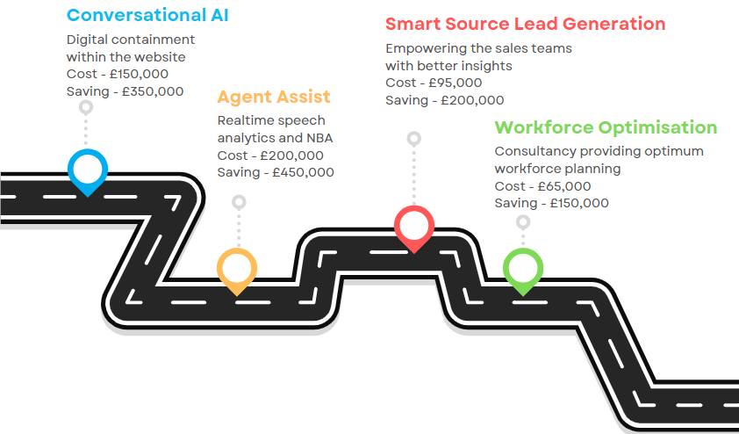
Digital transformation roadmap

Slide 36
In Summary
Who are you transforming for?
What is your overarching strategy?
What does your data tell you?
Develop a roadmap to digital transformation
You CAN deliver successfully in increments

Slide 37
Any Questions?
………before lunch

