Slide 1
Introducing Bryan Glick
Notes:
SK to provide - Bryan overview

Slide 2
European IT Priorities – the trends driving IT spending
Bryan Glick
Editor in chief, Computer Weekly

Slide 3
Agenda
About the TechTarget / Computer Weekly IT Priorities Survey
Budgets & broad initiatives
Top trends and observations
What IT leaders are telling us

Slide 4
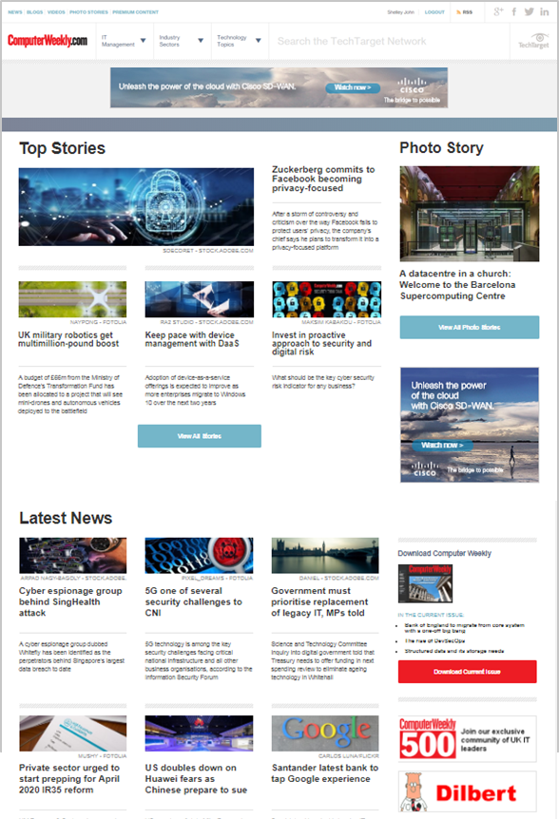
Computer Weekly
The leading European provider of news, analysis, opinion, information and services for the international IT community
56 years of history! Launched in 1966, Computer Weekly magazine was the first weekly technology publication in the world
Computer Weekly helps senior IT professionals:
Make better IT strategy and technology purchasing decisions;
Improve their knowledge and skills, and develop their careers;
Connect with the people and information they need to be successful in their jobs.
IT management and industry focus, as well as technology topics
Local content for Asia-Pacific, Nordics, Benelux, Middle East
Now available in local languages in Germany, Latin America (Spanish and Brazilian Portuguese) & sister-title LeMagIT in France
Feb 2020
Notes:
Add social icons

Slide 5
IT Priorities Survey Snapshot / Demographics
Surveyed large enterprises and SMEs
Company Size:
Deployed to members of TechTarget’s active audience in Europe
848 qualified respondents
in Europe
Job Functions:
Top industries represented:
C-level/VP/ Director | 28%
Managers | 28%
Staff | 44%
Government Administration
Rail
Higher Education
Banking / Financial Services
International Affairs
Automotive
Electrical/Electrical Manufacturing
Source: 2022 IT Priorities Europe | n=848
Notes:
Staff 43% (63)
Manager 24% (35)
Director 23% (34)
Analyst 12% (17)
Other 10% (Consultants 10 + Other 5)
C-Level 6% (9)
VP 4% (6)
Architect 3% (5)
Bucketed:
Staff 34%
Managers & Analysts 28%
Directors & Architects 21%
C-Level & VP 16%

Slide 6
Who we surveyed Areas of responsibility
Observations:
Which technology area(s) are you most focused on? (Choose all that apply)
Most respondents have responsibility for 2+ functional areas—they wear multiple hats
Employees at larger organizations tend to be more specialized
Source: 2022 IT Priorities Europe | n=749

Slide 7
Top observations for the next 12 months
Notes:
Click to access library XXX

Slide 8
Budget expectations
Observations:
How does your organisation’s technology budget for 2022 differ from your 2021 budget?
Buyers are optimistic about their tech budgets for the year
Only 7% of European firms expected a budget decrease from 2021 level–down from 31% during the pandemic
42% will increase by 5% or more
7% will decrease by 5% or more
£
51% will remain about the same
Source: 2022 IT Priorities Europe | n=553

Slide 9
Quick Take: 12 technologies that are more important to business this year
Observations:
Cloud and investments in modernizing end user computing and experience management point to greater IT/Business alignment
Safely extracting value from data through analytics and data management gain increased importance
Same top 12 as North America
In response to the global pandemic and other changes, which of the following broad technologies have become more important to your organization’s future than they were before? (Choose all that apply)
Security / Risk Management
Cloud Computing / Storage
Digital Workspaces / Mobility / EUC
Business / IT Automation
Data Management & Governance
Employee Experience
Customer Experience
Systems / Application Monitoring & Tools
ITSM
BC/DR
Unified Communications & Collaboration
AI / Data Science / ML
Source: 2022 IT Priorities Europe | n=614

Slide 10
Broad technology shifts Security, Cloud, EUC & Automation more important to business future
Observations:
Cloud and investments in modernising end-user computing and experience management point to greater IT/business alignment
Safely extracting value from data through analytics and data management is of increased importance
Same top 12 as North America
In response to the global pandemic and other changes, which of the following broad technologies have become more important to your organisation’s future than they were before? (Choose all that apply)
Source: 2022 IT Priorities Europe| n=614

Slide 11
IT Priorities Post-pandemic impact
& major trends

Slide 12
“Future of Work” initiatives are high priority in large enterprises
Observations:
What is your organisation’s current posture as it relates to supporting a digital-ready workplace and hybrid work environment [often described as “Future of Work”?
Here’s what FoW buyers are likely to be considering:
Unified communications platform (incorporating voice, video, messaging, screen sharing)
AI-enabled monitoring tools (incl. AIOps, APM, cloud, DevOps, log, metrics)
Productivity suites (i.e., Microsoft 365, Google Workspace)
Platform as a Service (PaaS)
Internet of Things (IoT) network infrastructure
Investing Aggressively in Future of Work:
Source: 2022 IT Priorities Europe | n=614

Slide 13
IT / Cloud strategy Four in 10 organisations are “cloud first”
Observations:
Which of the following best describes your organisation’s overall IT/Cloud strategy?
“Cloud first” used to be an exception, now 39% of European organisations have a cloud bias
Agnostics act like cloud-first buyers in most areas
39% Cloud first
DevOps
Edge Computing / IoT / IIoT
Cloud (incl. computing, storage, apps, etc.)
Customer Experience
Business Continuity / DR
34% Agnostic
On-premises infrastructure
Managed Services (i.e., MSP, CSP, VAR, Consultants, etc.)
Unified Communications & Collaboration
IT Asset Management (software, hardware)
Customer Experience
28% On-premises first
Core Apps (incl. ERP, HR, financial)
Training, Certification and/or skills development
On-premises infrastructure (Network/Compute, Storage)
Unified Communications & Collaboration
Employee Experience
Source: 2022 IT Priorities Europe | n=614

Slide 14
85% of those surveyed in Europe are actively adopting automation
Which of the following best describes the use of automation across your organisation? (Select one)
39% | We're leveraging automation to optimise BOTH IT and business workflows
17% | We're leveraging automation to optimise IT workflows
13% | We're leveraging automation to optimise business process workflows
16% | We have plans to leverage automation in the next 12 months
15% | We have no immediate plans to leverage automation
85% of orgs are investing in automation
Automation is used by most respondents to optimise both business and tech workflows
1 in 6 will launch first-time automation projects during the coming year
72% of ‘cloud-first’ organisations leverage automation currently
IT automation is consistent regardless of cloud or on-premises bias. Business automation is more likely at “cloud-first” organisations
Advanced automation users the most likely to be interested in AWS Outposts, Azure Stack, hardware options
Source: 2022 IT Priorities Europe | n=614

Slide 15
All Respondents Most Popular Projects in Europe
Security awareness training
Multifactor authentication
Data Privacy, governance, and protection compliance regulations (CCPA-CPRA, GDPR, etc.)
API gateway / management
Cloud Storage – From the data center to centers of data
Mobile devices refresh (incl. smartphones, tablets, laptops)
Managed network services (i.e., VNFs, security, WAN, network management)
Business process management / automation
Analytics/BI platform (incl. augmented analytics, data vis, self-service BI)
CRM and sales management
Risk assessment and visibility tools and services
VPN/NAC (remote access; as a networking initiative)
Ransomware protection
ERP
Single sign-on (SSO)
Data quality
Team collaboration / messaging software
Disaster recovery
Productivity suites (i.e., Microsoft 365, Google Workspace)
Microservices
69%
are leveraging Automation
describe themselves as “cloud first”
39%
intend to leverage MSPs in 2022 – a new record high
86%
Source: 2022 IT Priorities (Europe)

Slide 16
Company Sizes 1000+ Most Popular Projects in Large Enterprises
Security awareness training
API gateway / management
Multifactor authentication
Data Privacy, governance, and protection compliance regulations (CCPA-CPRA, GDPR, etc.)
Cloud Storage – From the data center to centers of data
ERP
IT automation tools
Managed network services (i.e., VNFs, security, WAN, network management)
CRM and sales management
Business process management / automation
Mobile devices refresh (incl. smartphones, tablets, laptops)
Ransomware protection
Analytics/BI platform (incl. augmented analytics, data vis, self-service BI)
Risk assessment and visibility tools and services
SD-WAN
Data quality
Security scanning/testing
Core HR Software
Disaster recovery
Off-premise cloud
Data governance
33%
are increasing budgets in 2022
are investing aggressively in Future of Work
28%
72%
are leveraging Automation
Source: 2022 IT Priorities (Europe)

Slide 17
IT Priorities What IT leaders are telling us: Accelerating innovation

Slide 18
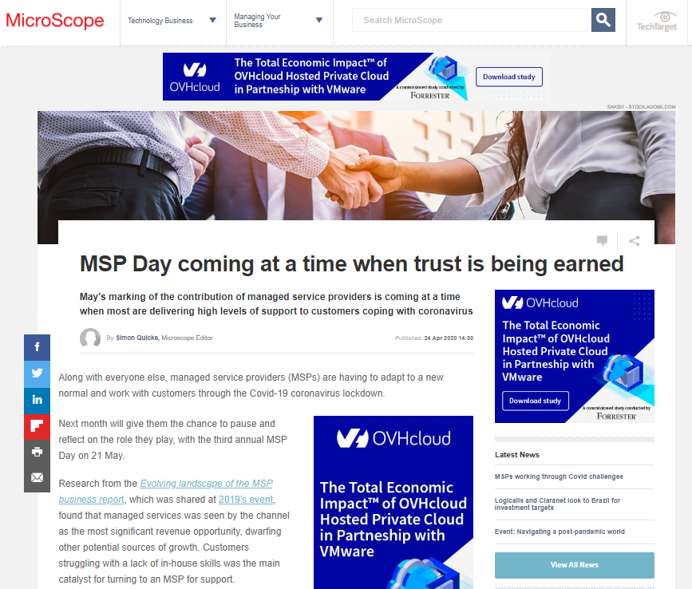
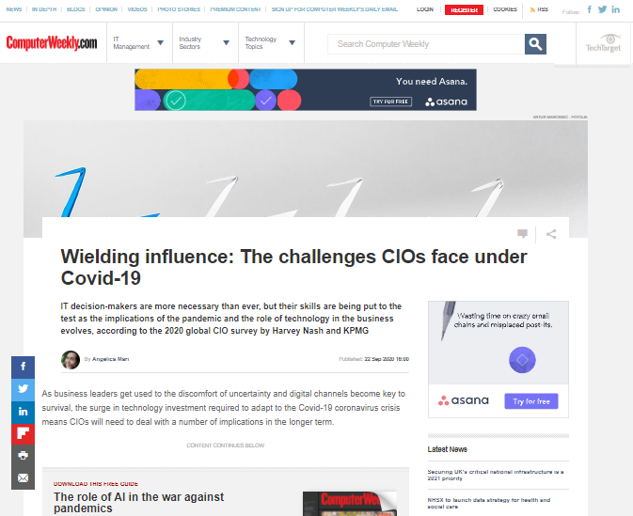
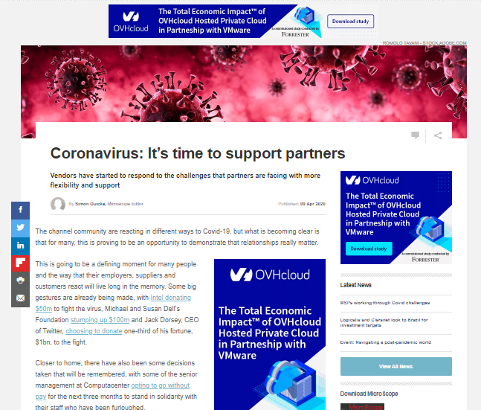
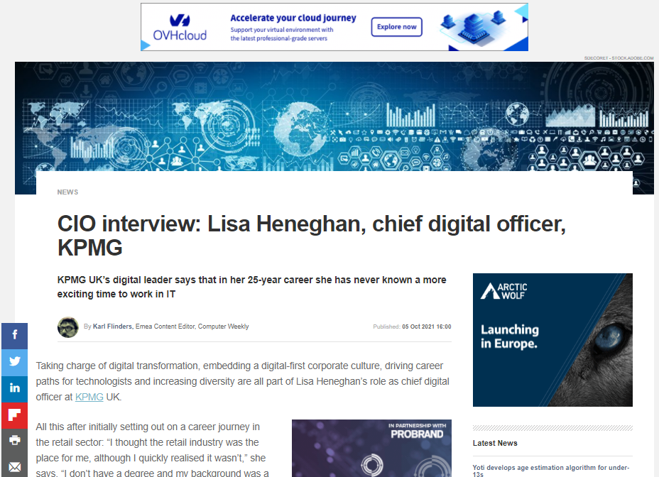
How do IT leaders see the future post-pandemic?
KPMG
“Gone are the days when businesses say they want to embark on an enterprise transformation programme that is going to last three years and cost several hundred million. Actually, what they are needing to do is drive change very quickly…it is the most exciting time in my 25-year career to be in technology.”
Lisa Heneghan, Chief digital officer, UK
Notes:
What we have seen, both from the data and anecdotally from our discussions with IT leaders, is that the organisations that are most advanced in their digital transformation are faring best in lockdown; while those that aren’t are accelerating that process. Digital transformation has become a priority initiative for any firm looking to survive and thrive in the coming months and years.
This quote is entirely typical of where IT decison-makers now find themselves. We talked to Jason Oliver from University of Sussex in the middle of April, as he had just had to implement much of the digital transformation plan he had carefully crafted over the previous 12 months, in just two weeks.
I know of an IT director at a huge US healthcare company that converted 130,000 employees to home working, also in a fortnight.
IT teams have shown their value during this crisis – but they’ve also demonstrated why things will never be the same for IT leaders from now on.

Slide 19
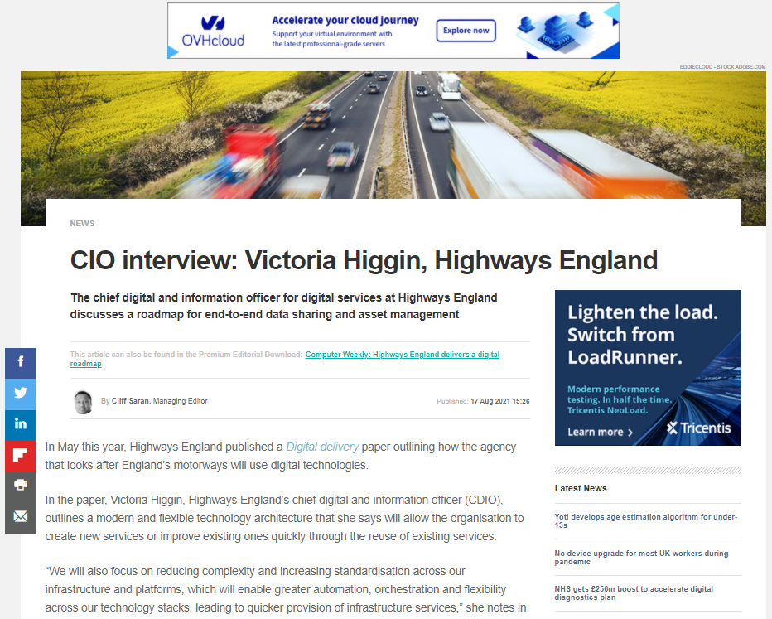
How do IT leaders see the future post-pandemic?
Highways England
“We will focus on reducing complexity and increasing standardisation across our infrastructure and platforms, which will enable greater automation, orchestration and flexibility across our technology stacks, leading to quicker provision of infrastructure services.”
Victoria Higgin, Chief digital and information officer (until June 2022)
Notes:
What we have seen, both from the data and anecdotally from our discussions with IT leaders, is that the organisations that are most advanced in their digital transformation are faring best in lockdown; while those that aren’t are accelerating that process. Digital transformation has become a priority initiative for any firm looking to survive and thrive in the coming months and years.
This quote is entirely typical of where IT decison-makers now find themselves. We talked to Jason Oliver from University of Sussex in the middle of April, as he had just had to implement much of the digital transformation plan he had carefully crafted over the previous 12 months, in just two weeks.
I know of an IT director at a huge US healthcare company that converted 130,000 employees to home working, also in a fortnight.
IT teams have shown their value during this crisis – but they’ve also demonstrated why things will never be the same for IT leaders from now on.

Slide 20
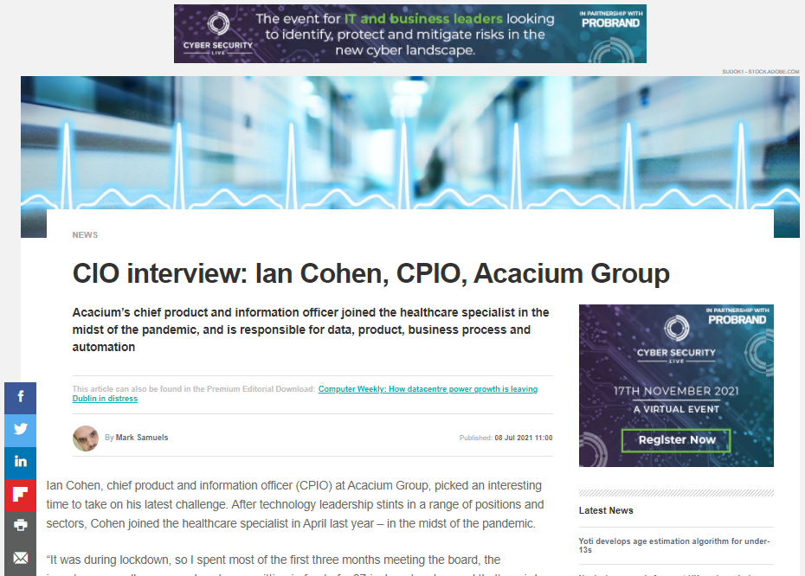
How do IT leaders see the future post-pandemic?
Acacium
“We stood up a whole vaccination facility in 11 days. That includes workforce, identity, logistics, delivery services and data, both in terms of analytics and reporting. Normally, that would have taken nearly three months.”
Ian Cohen, Chief product and information officer
Notes:
What we have seen, both from the data and anecdotally from our discussions with IT leaders, is that the organisations that are most advanced in their digital transformation are faring best in lockdown; while those that aren’t are accelerating that process. Digital transformation has become a priority initiative for any firm looking to survive and thrive in the coming months and years.
This quote is entirely typical of where IT decison-makers now find themselves. We talked to Jason Oliver from University of Sussex in the middle of April, as he had just had to implement much of the digital transformation plan he had carefully crafted over the previous 12 months, in just two weeks.
I know of an IT director at a huge US healthcare company that converted 130,000 employees to home working, also in a fortnight.
IT teams have shown their value during this crisis – but they’ve also demonstrated why things will never be the same for IT leaders from now on.

Slide 21
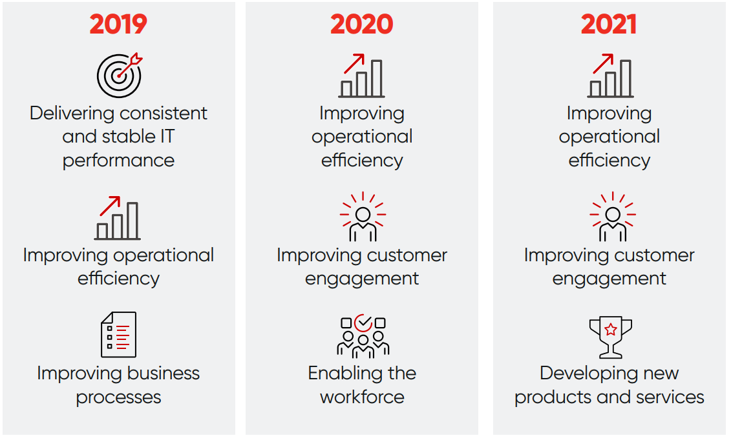
The evolution of innovation
What are the top three business aims that your management board is looking for technology to address?
“There is a new emphasis on ‘Developing new products and services’. In 2019, this factor was tenth on the list and now it is in the top three.”
Source: Harvey Nash Group Digital Leadership Report (November 2021)

Slide 22
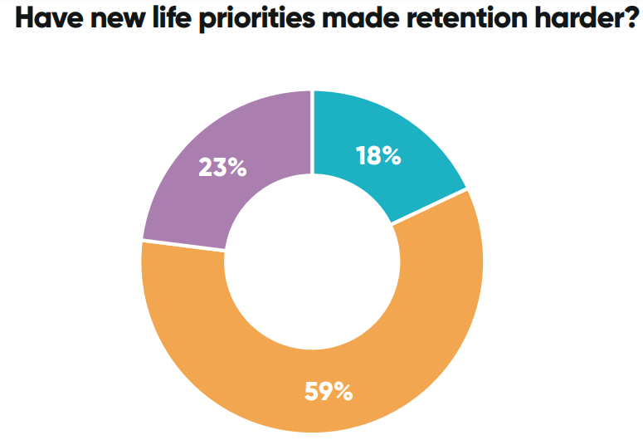
Employee impact and engagement
“82% of respondents said the pandemic has made their staff reconsider life priorities and made the job of retention harder to some extent or worse. Increasingly, staff and potential hires will be looking at the purpose of an organisation when making their career decisions.”
Source: Harvey Nash Digital Leadership Report
To what extent has the crisis made your staff reconsider their life priorities and made retention harder?

Slide 23
How’s 2022 looking – and 2023?
Gartner: 69% of boards have responded to Covid-19 with digital business acceleration
Worldwide IT Spending Forecast – July 2022 (US$ Millions)
 | 2021 Spending | 2021 Growth (%) | 2022 Spending | 2022 Growth (%) | 2023 Spending | 2023 Growth (%)
Datacentre Systems | 191,001 | 6.4 | 212,218 | 11.1 | 221,590 | 4.4
Enterprise Software | 735,869 | 14.7 | 806,800 | 9.6 | 902,182 | 11.8
Devices | 808,580 | 16.0 | 767,872 | -5.0 | 790,888 | 3.0
IT Services | 1,207,966 | 12.8 | 1,283,192 | 6.2 | 1,389,169 | 8.3
Comms Services | 1,458,527 | 3.8 | 1,464,551 | 0.4 | 1,505,733 | 2.8
Overall IT | 4,401,944 | 10.2 | 4,534,632 | 3.0 | 4,809,561 | 6.1
“Last year, IT spending took the form of a ‘knee-jerk’ reaction to enable a remote workforce in a matter of weeks. As hybrid work takes hold, CIOs will focus on spending that enables innovation.” John-David Lovelock Gartner
Source: Gartner (October 2021)

Slide 24
Europe IT Priorities - High Level Takeaways
2022 is going to be a good year.
While the pandemic delayed or disrupted many projects (especially "on-premises" projects), 2022 figures point to a recovery at or above pre-pandemic levels.
Security is everyone’s job.
Security won big in redirected attention: 57% agree that security is more important, due to changes driven by the pandemic.
39% of European orgs describe themselves as "cloud-first"
These respondents also have the most aggressive spending plans
The Future of Work is a major investment area.
91% of European organisations are investing in the “the future of work,” and 1-in-4 are investing aggressively / proactively.
Partnering with Managed Service Providers (MSPs) is an established
Strategy for end users.
86% are planning to use MSPs (up from 75% in 2021).
Automation is a top priority for both business and technology workflow optimisation.
Internet of Things (IoT) investment is expanding related to edge, security, on-premises investments, distributed cloud and more.
Ransomware protection purchase intent has grown 59% since 2021, reflecting growth in the awareness and business impact of data security.
Source: 2022 IT Priorities Europe | n=848

Slide 25
IT buying priorities for the next 12 months
Key theme is accelerating innovation – for business reasons now, not for Covid reasons
Covid changes are being embedded in organisations – especially around future workplace
Leading companies will be more automated, more data-driven, cloud-first, hybrid workplaces
Close followers will have to keep pace
Physical transition to remote / hybrid working now leading to reassessment of employee wellbeing, engagement, HR
Sustainability is a fast-growing boardroom issue, which in turn will drive IT

Slide 26
Any questions?
bglick@techtarget.com
@bryanglick
Notes:
Click to access library XXX

